Slide 1

Leveraging partnerships to improve assimilation of reconnaissance data
Jason Sippel

Slide 2
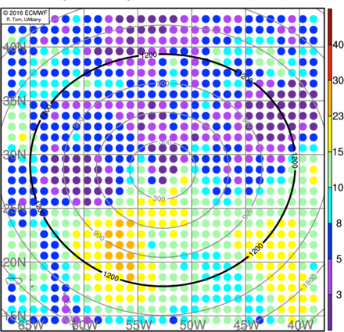
Evolving use of recon data
OLD
Recon paradigm shift
Model & data assimilation (DA) improvements
Strategic sampling
Smarter use of resources
NEW
Courtesy SUNY Albany

Slide 3
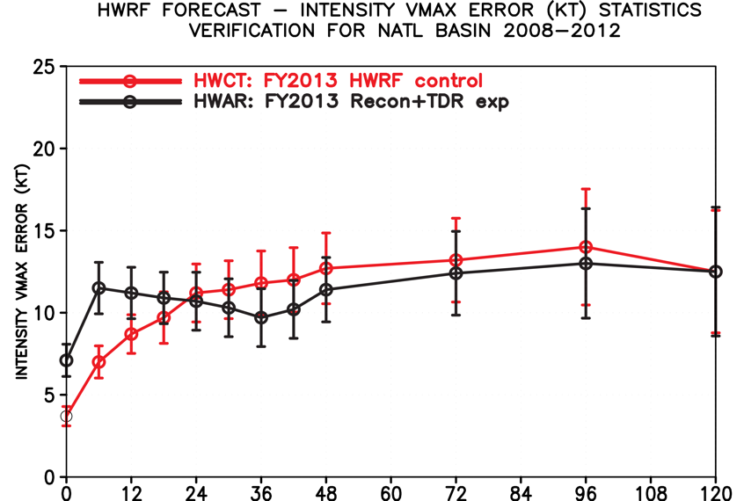
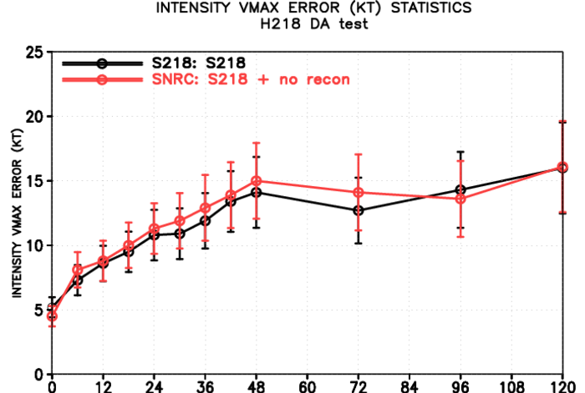
Better modeling and DA improves obs. impact
2013 HWRF recon impact: Intensity
2018 HWRF recon impact: Intensity
No recon
Recon
Larger errors with recon
Day1 Day2 Day3 Day4 Day5
Day1 Day2 Day3 Day4 Day5

Slide 4

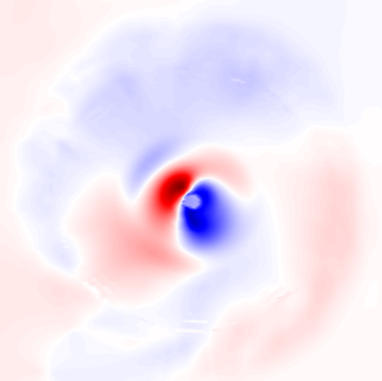
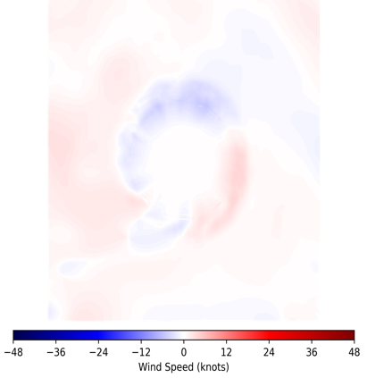
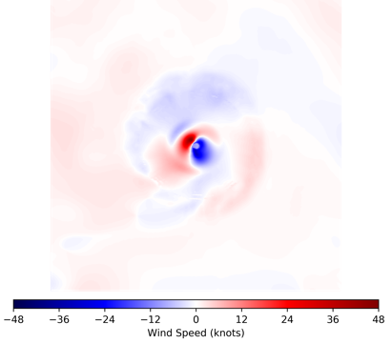
Inner-core data impact: EMC/HRD collaboration
Analysis impact
Analysis impact
Impact on HWRF intensity errors
300 km
300 km
TC inner core
OLD
TC inner core
Large impact
No impact
Large impact
NEW
Large impact
No impact
Large impact
OLD method
NEW method
Day1 Day2 Day3 Day4 Day5

Slide 5

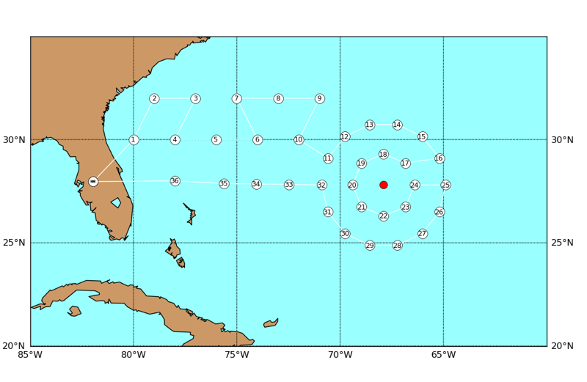

Improving G-IV usage: NHC/HRD collaboration
New G-IV “double circumnav”
NOAA G-IV
GIV TDR impact: Intensity bias
WITH TDR
Less adjustment with GIV TDR
NO TDR
Day1 Day2 Day3 Day4 Day5

Slide 6
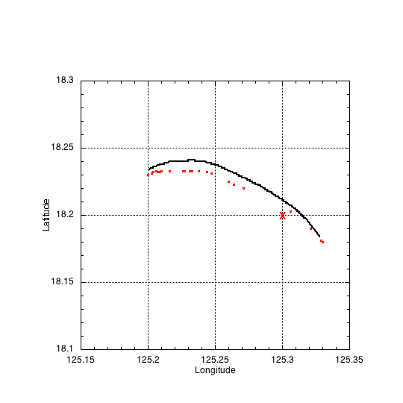
Improving sonde usage: EMC/HRD collaboration
Dropsonde location (drift)
Drift impact on HWRF intensity errors
NO DRIFT
~15 km
Observed location
HRD estimation
WITH DRIFT
X
NCEP location
Day1 Day2 Day3 Day4 Day5

Slide 7
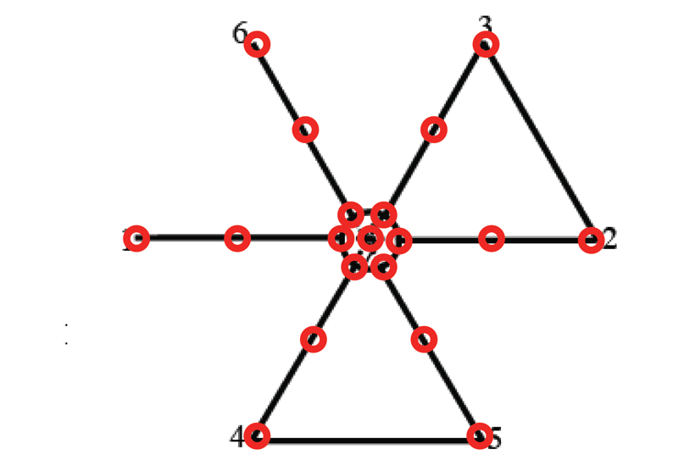
Improving dropsonde usage: R2O transition
Joint Technology Transfer Initiative (JTTI) Project funded FY18-FY19
R2O in HWRF both FY18 & FY19 (Readiness level 9)
Likely R2O in FV3-GFS FY20
Typical flight pattern and dropsonde locations

Slide 8
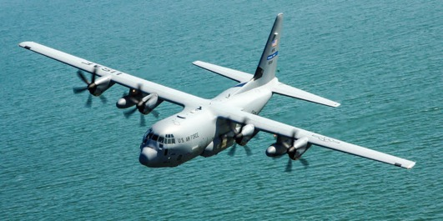
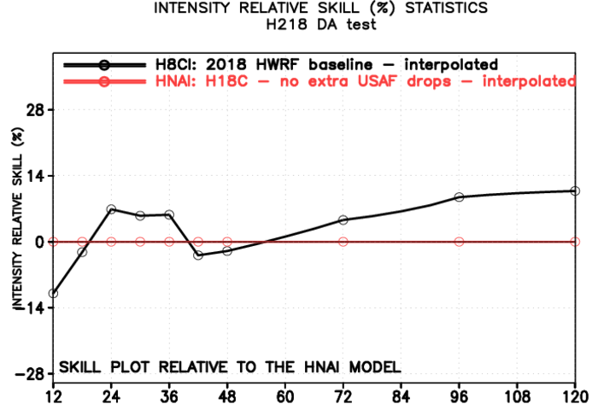

Increased dropsonde sampling: NHC/HRD collaboration
Dropsonde impact on intensity skill
USAF C130
WITH DROPS BETTER
Typical USAF
pattern
NO DROPS BETTER
Add dropsondes at turn points
Day1 Day2 Day3 Day4 Day5

Slide 9
Closing Summary
Tremendous improvements in recon usage
Multi-agency collaboration
Better forecasts
Smarter use of resources

