Slide 1

Using Integrated Ecosystem Assessments to improve resource management
Kelly Montenero
Notes:
I’m Kelly Montenero, and I’ll be talking about Integrated Ecosystem Assessments and how they can be used to improve resource management

Slide 2
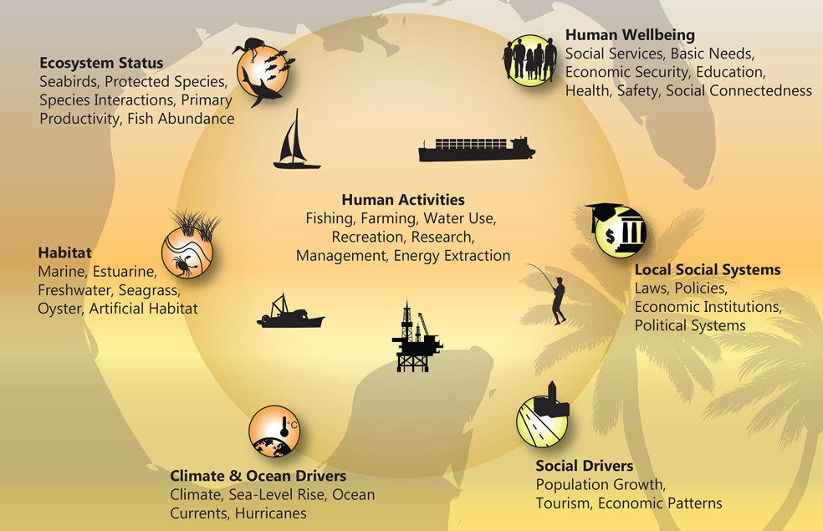
Integrated Ecosystem Assessments
Notes:
NOAA’s Integrated Ecosystem Assessments (IEA) are an approach to Ecosystem-Based Management. This integrates all components of an ecosystem, including humans, into the decision-making process of natural resource managers. The approach is a NOAA-wide initiative, but specific and flexible to regions. Inter disciplinary and inter line office, with the leadership for OAR at AOML

Slide 3
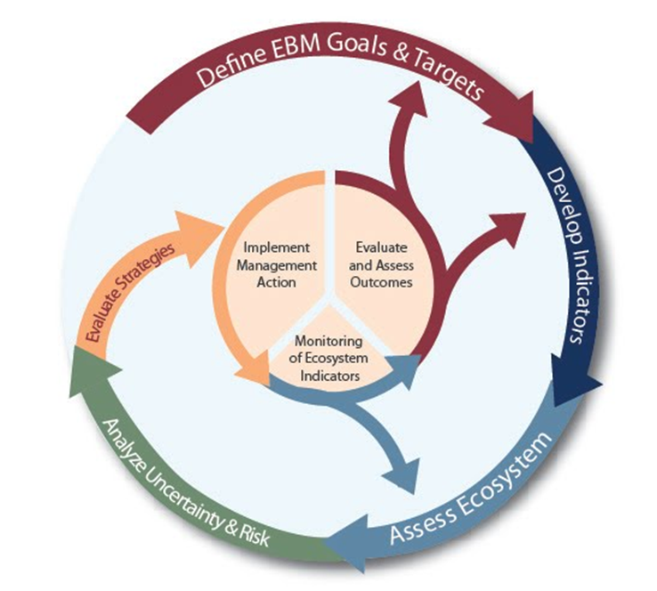
IEAs Provide an Analytical Framework to Implement EBM
Integrated Ecosystem Assessments:
Synthesize and analyze diverse data and ecosystem model outputs
Are modular, iterative, scale-able, and adaptable
Share common national framework with regional variation
Provide assessments for multiple ocean-use sectors
Notes:
IEAs are a decision support process using diverse data. They are modular, scalable and iterative, and the goal is to provide assessments of the ecosystem across ocean-use sectors.

Slide 4
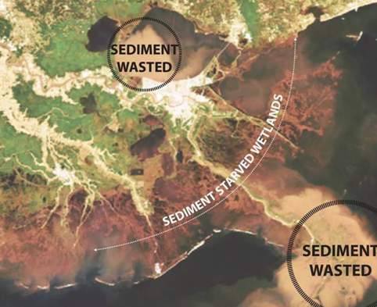
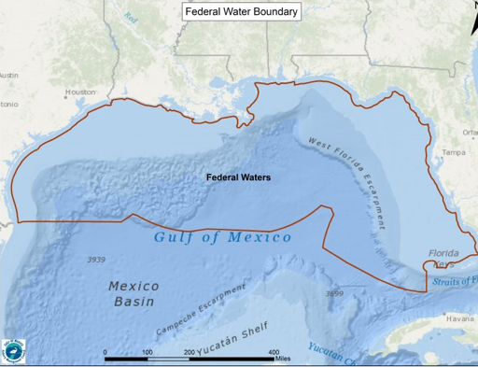
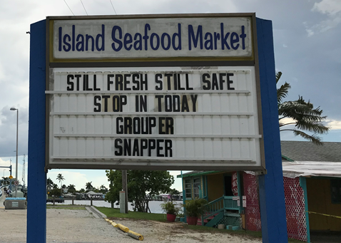
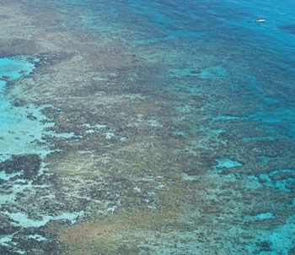
Gulf Of Mexico Integrated Ecosystem Assessment
Mid Barataria sediment diversions
Gulf of Mexico Fishery Management Council
Red tide (Southwest Florida coastal communities
Florida Keys National Marine Sanctuary
Notes:
The region headed up at AOML is the Gulf of Mexico IEA. There are four focal areas: sediment diversions in Louisiana, fisheries management council support, improving community resilience to red tide in SW Florida, and our work assessing ecosystem condition in the Florida Keys National Marine Sanctuary, which I’ll focus on.

Slide 5

Implementation in Florida Keys National Marine Sanctuary
NOAA’s IEA program partnered with the Office of National Marine Sanctuaries to advance the science behind Sanctuary condition reports and management plans
Identify Indicators for Sanctuary Condition Report and obtain data sets
Analyze status and trends of selected and vetted indicators, per Sanctuary Condition report format
Notes:
NOAA’s IEA program has been partnering with the Office of National Marine Sanctuaries to advance the science behind Sanctuary status and management. This is a great partnership to pair best science with a management body and process.
We developed a process to identify ecosystem and socioeconomic indicators that relate to the Sanctuary Condition Report. Condition reports are a way for Sanctuaries to track changes in condition to see when updates are necessary.
This was a vetted, qualitative and quantitative process centered around an expert workshop that we hosted. We then worked with partners to obtain data sets (6 from AOML monitoring), and then analyzed the status and trends of these indicators, especially focusing on the last 5 years. This approach is now being transferred to other sanctuaries in the system

Slide 6
Timeline of Florida Keys Integrated Ecosystem Assessment Work
Introduction of IEA approach to FKNMS managers
IEA/MBON/Sanctuary workshop
Draft EIS release by Sanctuary
September 2018
June 2019
May 2018
April 2019
August 2019
Indicator selection expert workshop
Sanctuary Advisory Council meeting
Notes:
The Sanctuary has been in a long process of updating its management plan, and when new leadership came in to the Sanctuary, we partnered to integrate IEA work into the update effort with indicator selection and product development. Some of our indicator analyses were able to support the DEIS and SAC briefing this summer

Slide 7
By the numbers
56
6
32
Indicators and sub indicators analyzed
Categories of indicators per Sanctuary Condition report
Experts who participated in Indicator selection workshop
Notes:
We ended up with 56 indicators and sub indicators, in 6 categories,

Slide 8





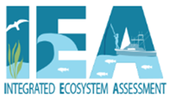





Partners
Integrated Ecosystem Assessment Partnerships
Notes:
thanks to the input of 32 experts who participated in our process and provided data, including AOML scientists.

Slide 9

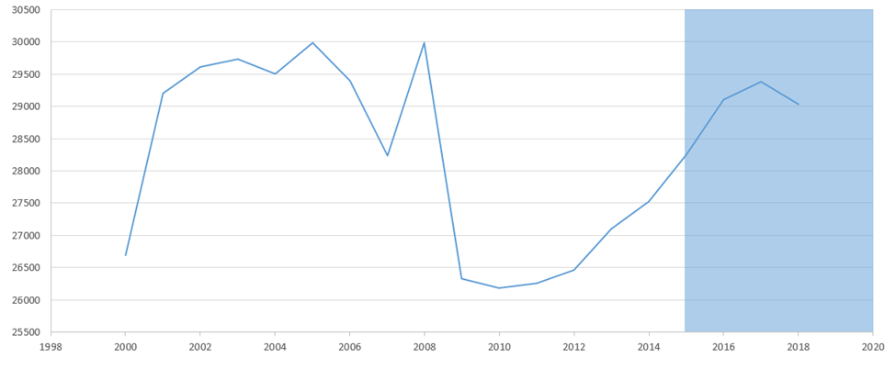
Status and Trends of Key Indicators
Total registered vessels in Monroe County
All vector graphics by Tracey Saxby, IAN UMCES image library
Notes:
Here’s the status and trends of a few key indicators. You can see a drop in total registered vessels concurrent with the recession, and a similar drop in total commercial fishing trips, both recovering

Slide 10

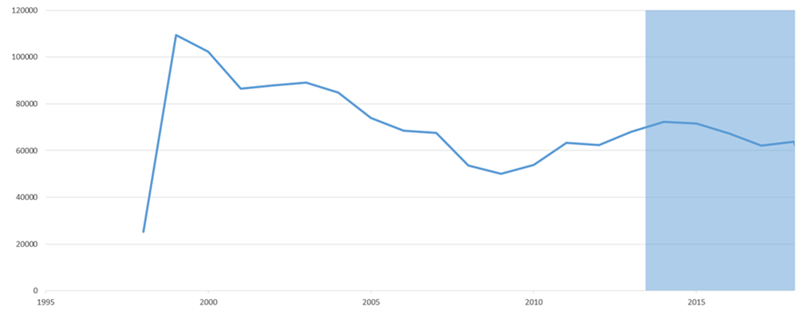
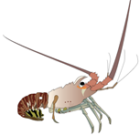
Status and Trends of Key Indicators
Total commercial fishing trips out of Monroe County

Slide 11

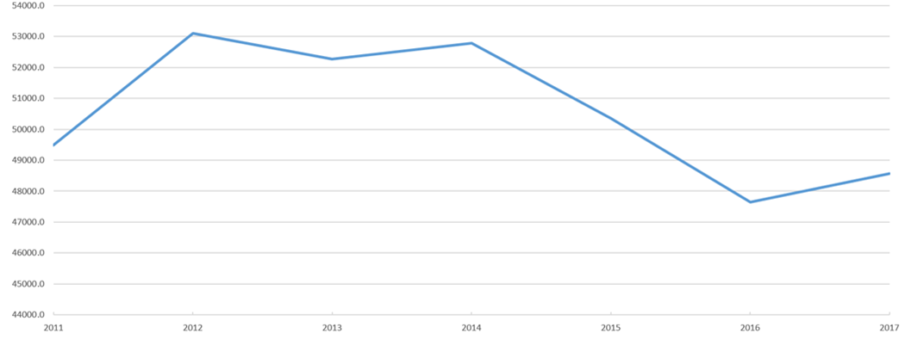
Status and Trends of Key Indicators
Stony coral live tissue area, Florida Keys 2011-2017
Notes:
We see a decline in stony coral live tissue area,

Slide 12

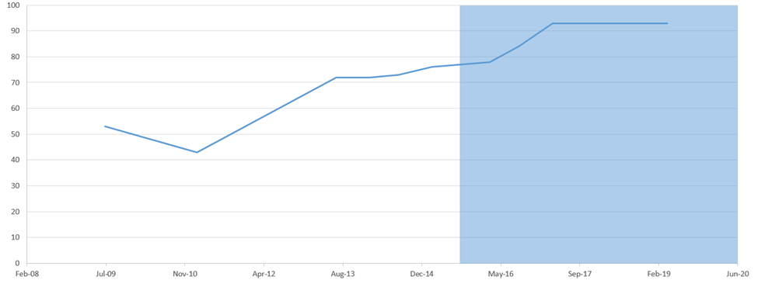
Status and Trends of Key Indicators
Total number of households connected to wastewater treatment
Notes:
There was an increase in households connected to central sewer in the Keys- good for water quality.

Slide 13
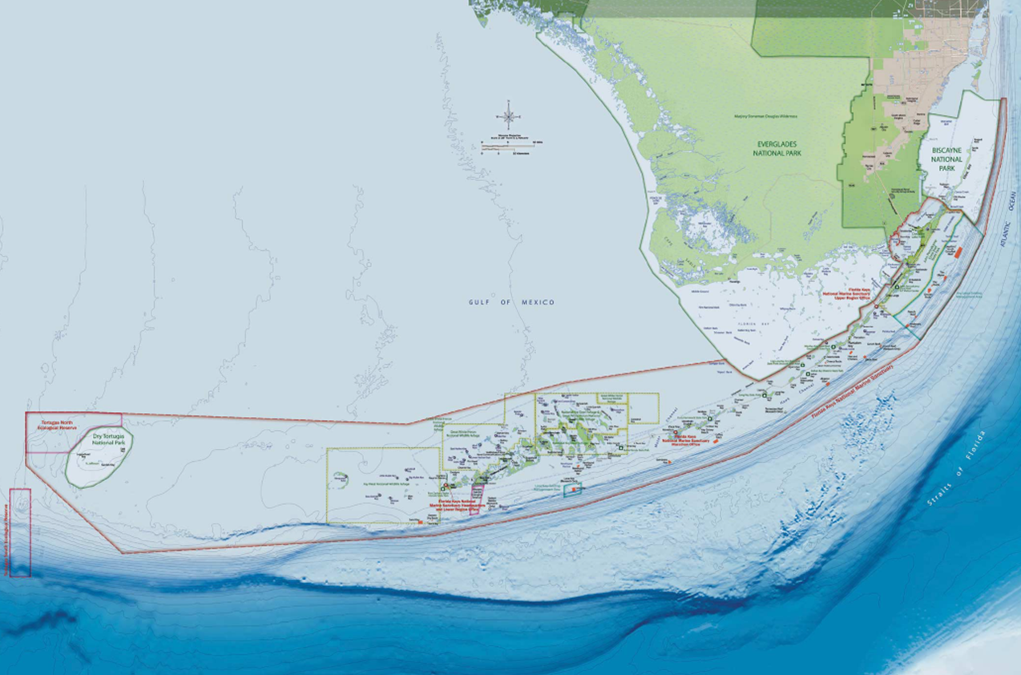
Indicator Adoption by Partners
Sanctuary management plan DEIS
Other Sanctuary condition report efforts
CRCP NCRMP status report
FWRI status report
Notes:
We’re happy that others in the research and resource management community are using our suite of indicators as well. They were used in sanctuary management plan update draft environmental impact statement, they will contribute to next sanctuary condition report
Dovetailing with NCRMP status report, requested to be used by FWRI , FIU and WVU work as well.

Slide 14
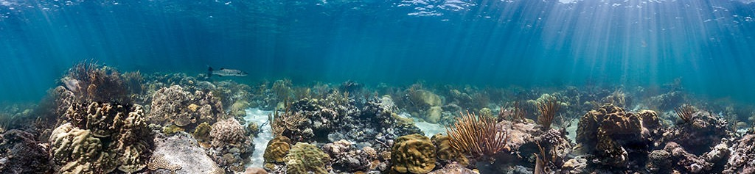
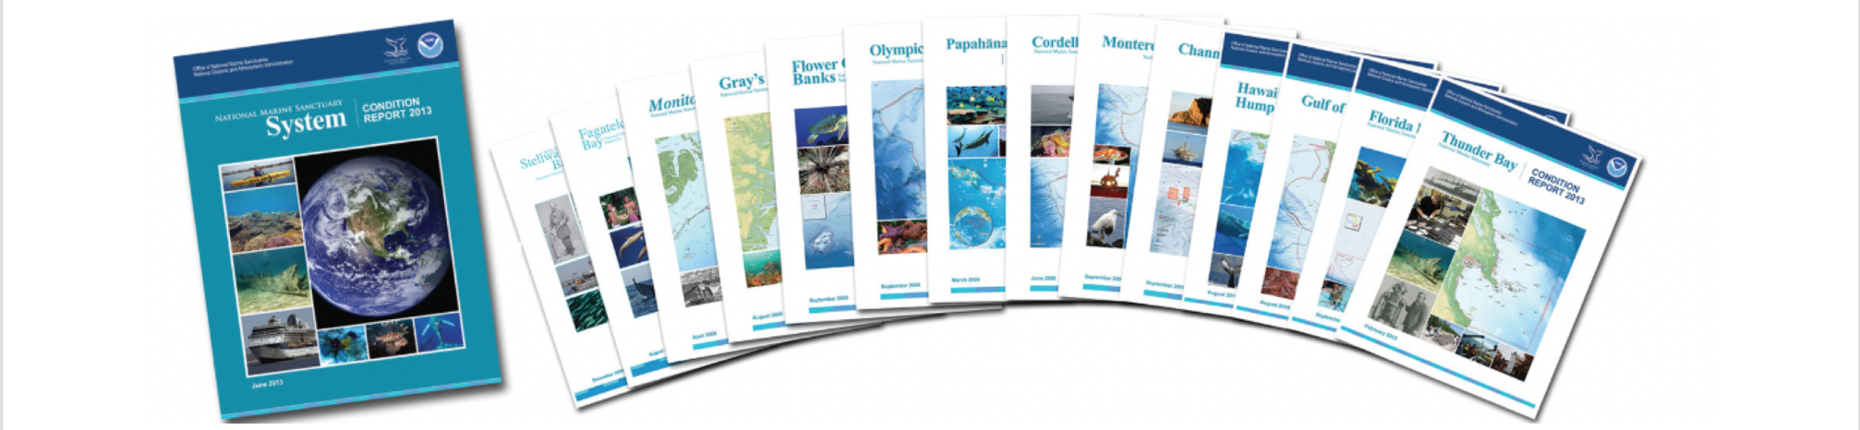
Next steps
Full IEA with threshold analysis and risk assessment to inform management in the FKNMS
Interactive web tool of key indicators and clickable conceptual model
Full updated condition report for Sanctuary
Risk assessments
Notes:
Our next steps:
Threshold analysis for risk assessment
Working on an interactive web tool of key indicators’ trends and a clickable conceptual model
Supporting a full updated condition report
We were asked by Office of National Marine Sanctuaries to transfer this work to other sanctuaries for indicator selection and condition report process
Interactive Tool for Key Indicators can be found here: https://www.aoml.noaa.gov/ocd/ocdweb/ESR_GOMIEA/lulc.html

Slide 15
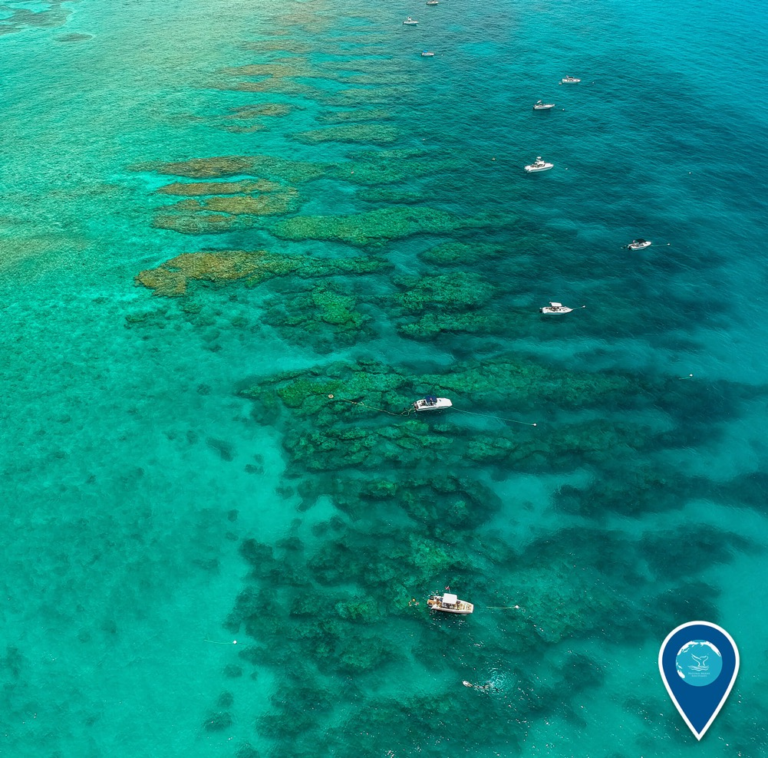
Summary
IEA provide best science for management decisions
Supports sustainable Blue Economy
Notes:
IEAs work to provide the best available science to inform management decisions, using a multi-step approach that provides a framework to support ecosystem-based management - integrating existing science and also building additional capacity to provide natural resource managers with a broader understanding of the ecosystem and make fully informed decisions. Our FKNMS work lead here at AOML is strong due to the interdisciplinary network of science and management partners. Our work can serve as an outreach and visualization tool to stakeholders, a novel quantitative and qualitative approach to selecting best fit indicators, a review of baseline conditions relevant to management actions and as science information for decisions regarding regulations, with the common effort of preserving and enjoying our national sanctuaries.

Slide 16
Thank you!

