Slide 1

The Ocean and Extreme Weather Events
Hosmay Lopez, PHOD

Slide 2
Weather
Sub-seasonal
Seasonal
Interannual
Multi-decadal
Prediction Timescales
One of the goals of our division is to monitor the ocean state in order to improve weather forecasts and outlooks beyond the synoptic timescales

Slide 3
Objective: U.S. Heat Waves, Their Prediction and Future Projections
We are committed to advance our understanding of the physical mechanisms that control the variability, predictability, and future projections of extreme heat waves events in the U.S.
Partner: NOAA/CPC

Slide 4
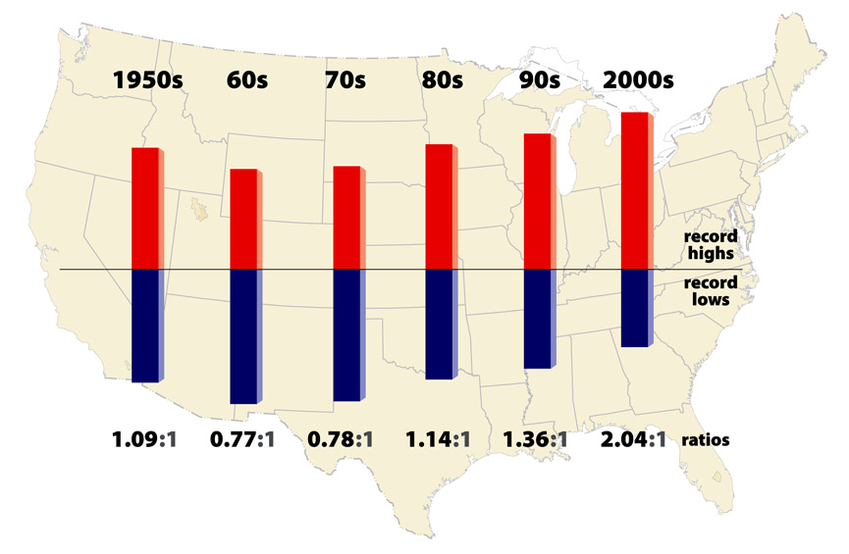
Why Heat Waves are Important?
In 2018, heat was responsible for 106 deaths, or about 25% of the total weather-related casualties in the U.S.
Some Examples:
1980 Midwest and Great Plains, US (1,700 deaths)
1995 event in Chicago, US (1,021 deaths).
2003 European heat wave (52,452 deaths).
2010 Russian event (55,736 deaths).
2011 US Great Plains (206 deaths).
2012 US Great Plains (155 deaths).
2015 Indian heat waves (2,500 deaths).
Meehl et al. 2009

Slide 5
The 2011 Heat Wave Event Caused 206 Fatalities
°C
Lopez et al. 2019
Heat waves can cover large area and persist for long periods of time
Partner: NOAA/CPC

Slide 6
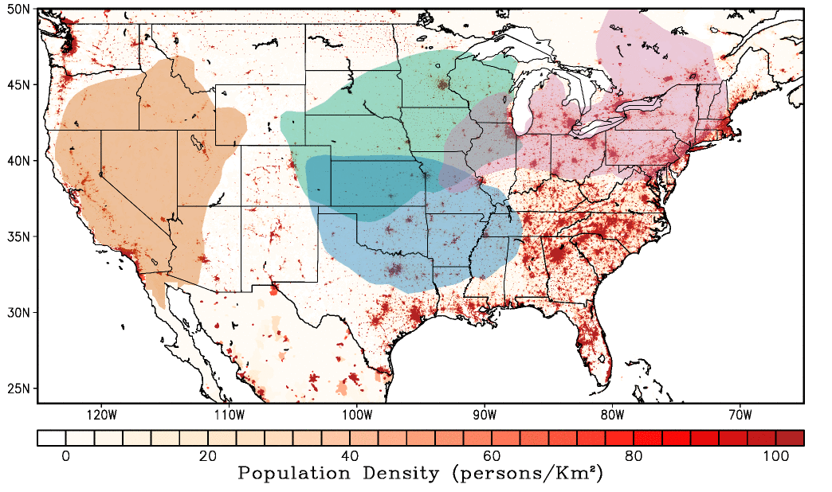
Future Projections of Heat Waves in the U.S.
Contribution of ACC to heat wave occurrence in the 21st Century
Northern Plains
Great Lakes
West
Southern Plains
A product (e.g., Time of Emergence) was created to diagnose the time at which ACC signal will emerge against background natural variability. This product should aid in mitigation and adaptation efforts
Lopez et al. 2018. Nature Climate Change
Funded by: NOAA/OAR

Slide 7
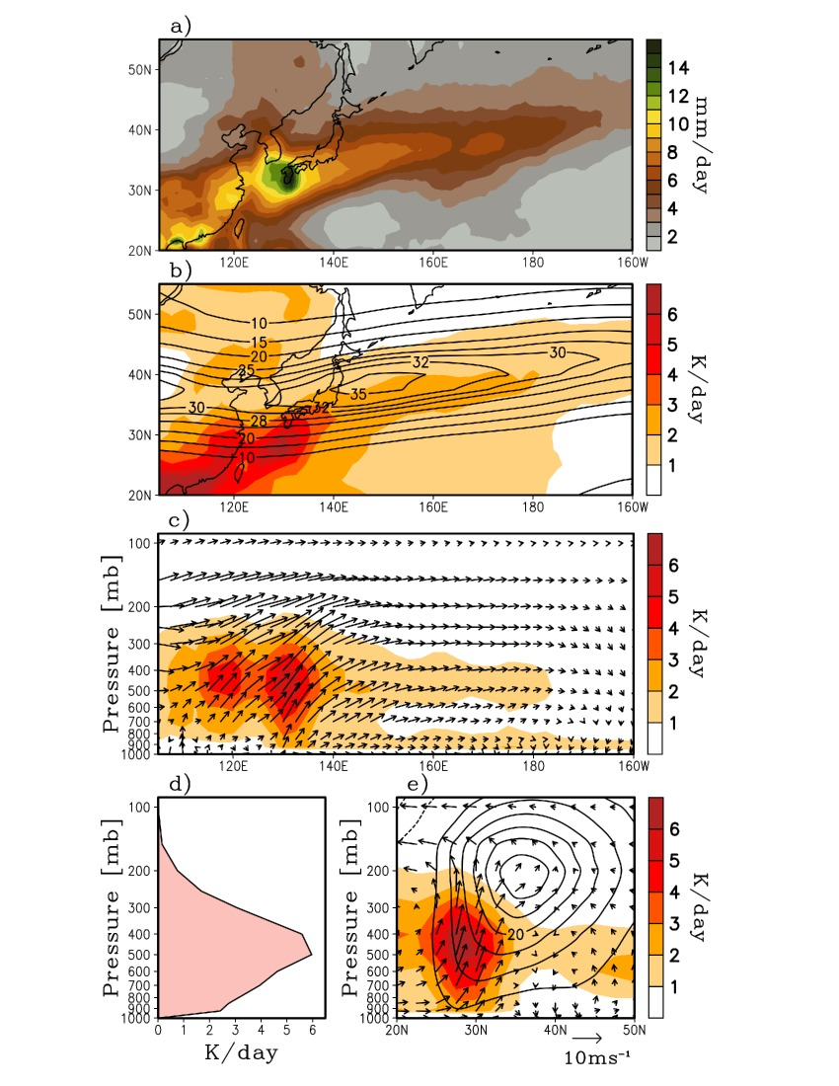
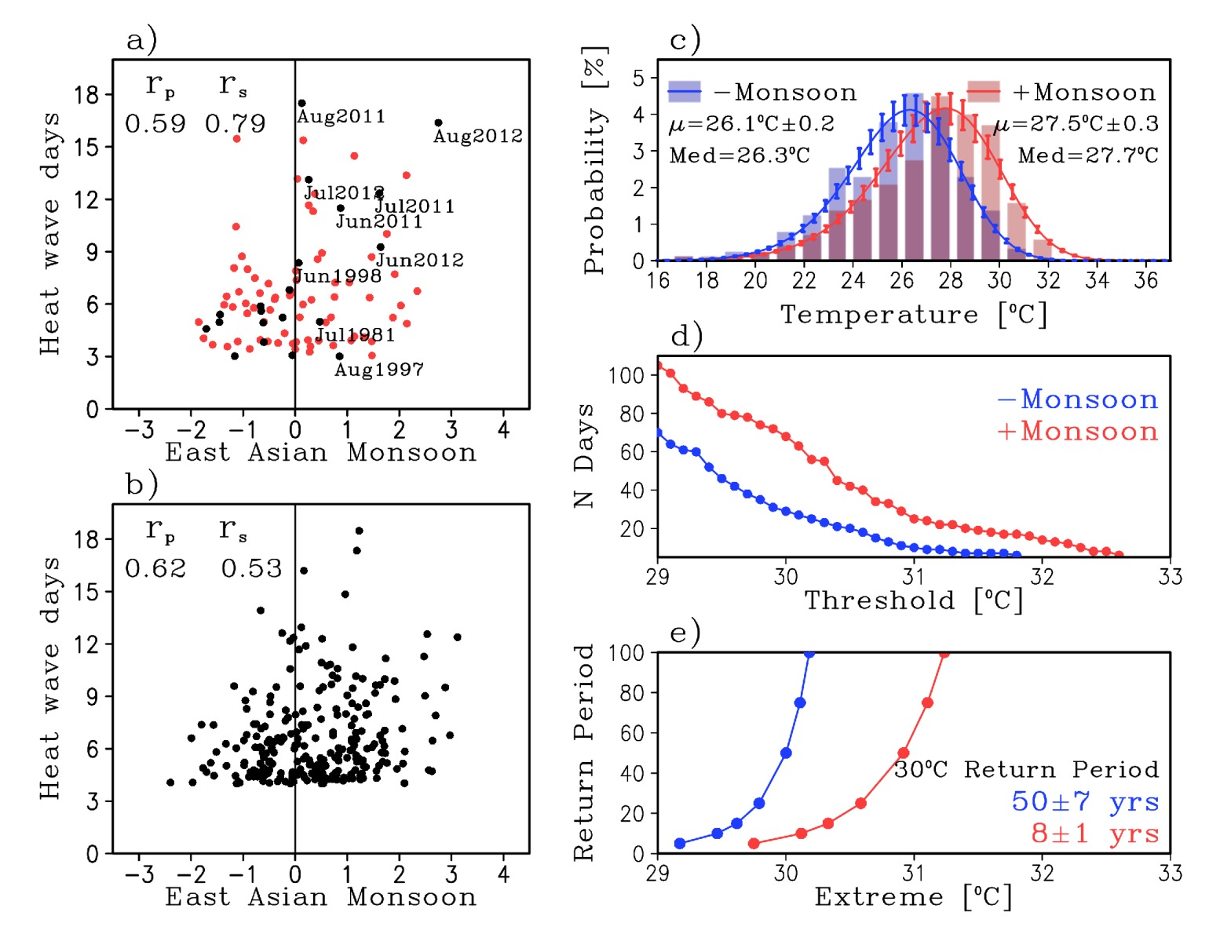
The Monsoons as a Predictor of U.S. Heat Waves
The East Asian Monsoon
Forces atmospheric
teleconnection patterns
High Pressure over North America
Increasing the likelihood of
heat waves in the U.S.
Lopez et al. 2019
During strong Monsoon, the likelihood of heat waves increases
Partner: NOAA/CPC

Slide 8
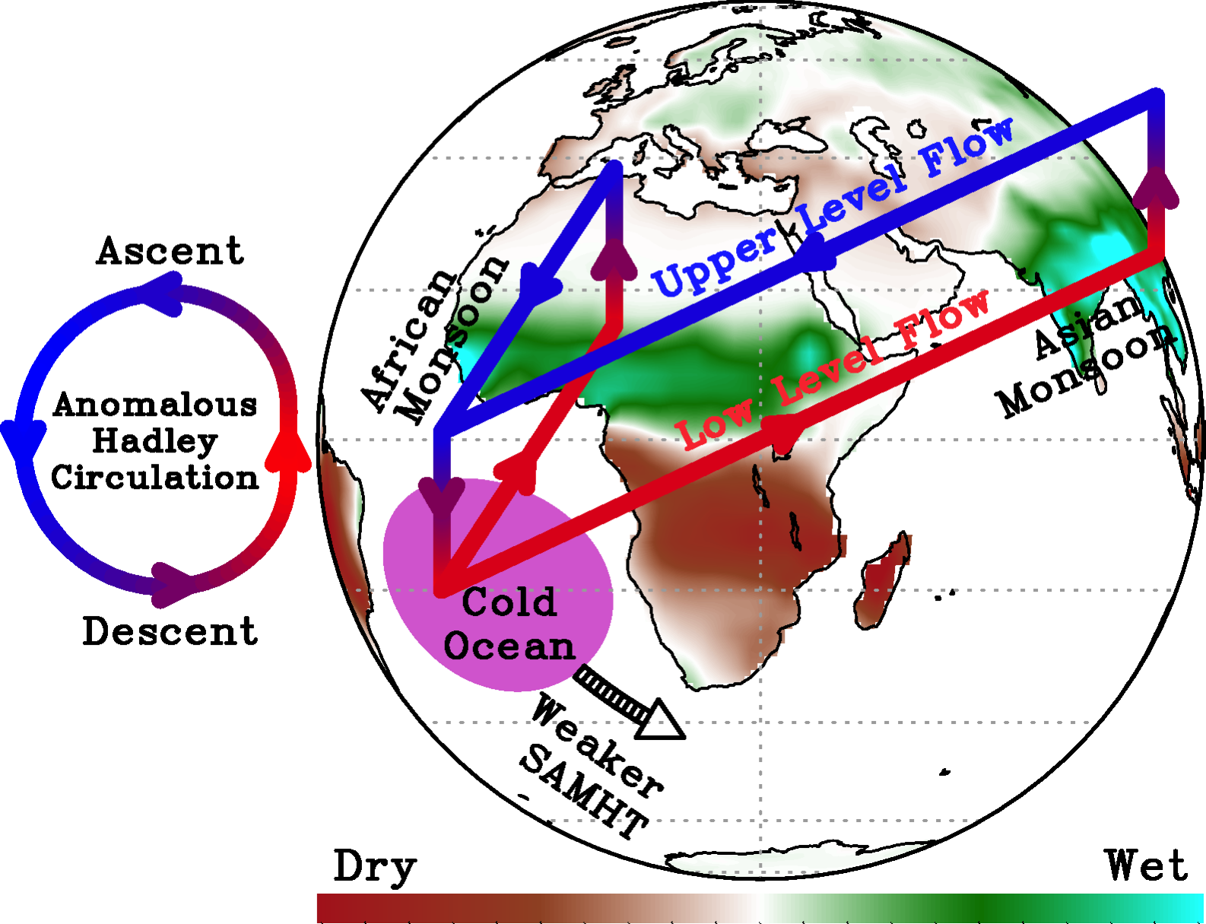
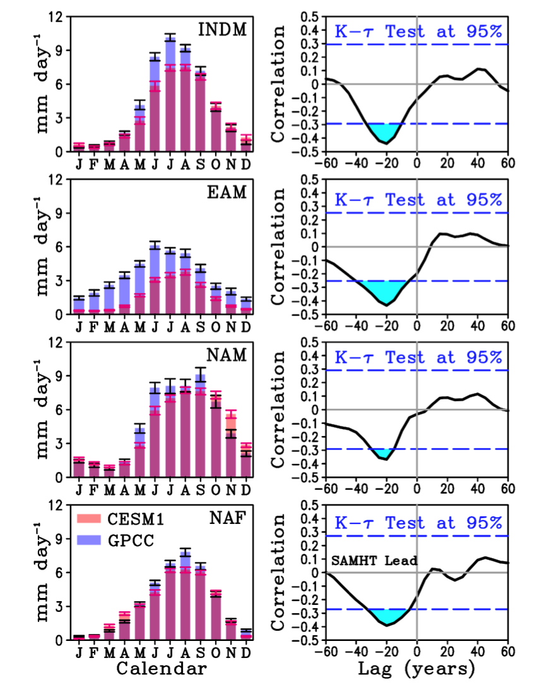
The South Atlantic Ocean as a Driver of Global Monsoons
N. American Monsoon
East Asian Monsoon
Weaker SAMHT leads to stronger NH monsoons about 20 years later
SAMHT: South Atlantic Meridional Heat Transport
Lopez et al. 2016
Funded by: NOAA/AOML

Slide 9
Decadal Predictions of North American heat waves: Role of the SAMHT
Heat wave composite, weak SAMHT at 20-yr lead
The SAMHT is identified as a source of heat wave predictability over the Great Plains.
Heat wave return period (Summers)
ERA-20th Century | 13 ± 8
Pre-industrial (strong SAMHT) | 73 ± 6
Pre-industrial (weak SAMHT) | 14 ± 7
Random Error Range | ± 12 at 95th percentile
Funded by: NOAA/OAR and NOAA/AOML

Slide 10
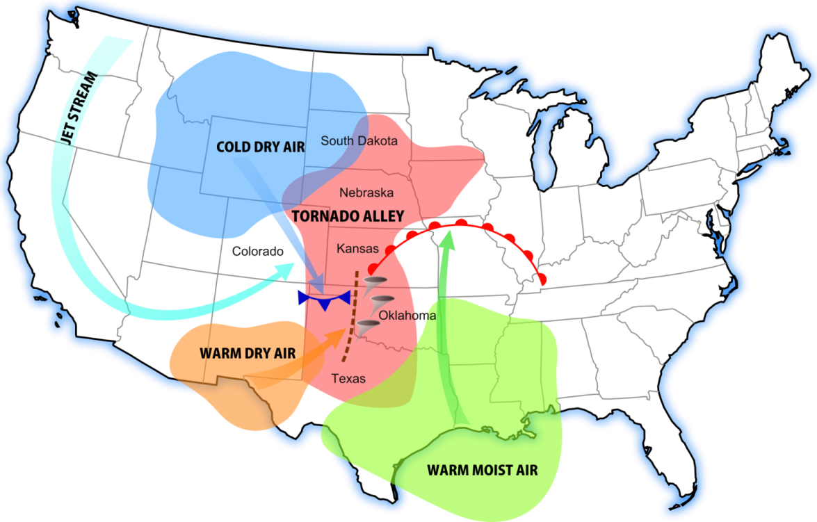
Seasonal Prediction System for U.S. Tornado Activity
Tornadoes are one of the top 3 most hazardous weather events in the US, along with heat waves and flooding.
There is a need to extend the current tornado forecast beyond the synoptic time scale into sub-seasonal time scale to prepare resources to save lives and protect critical infrastructure.

Slide 11
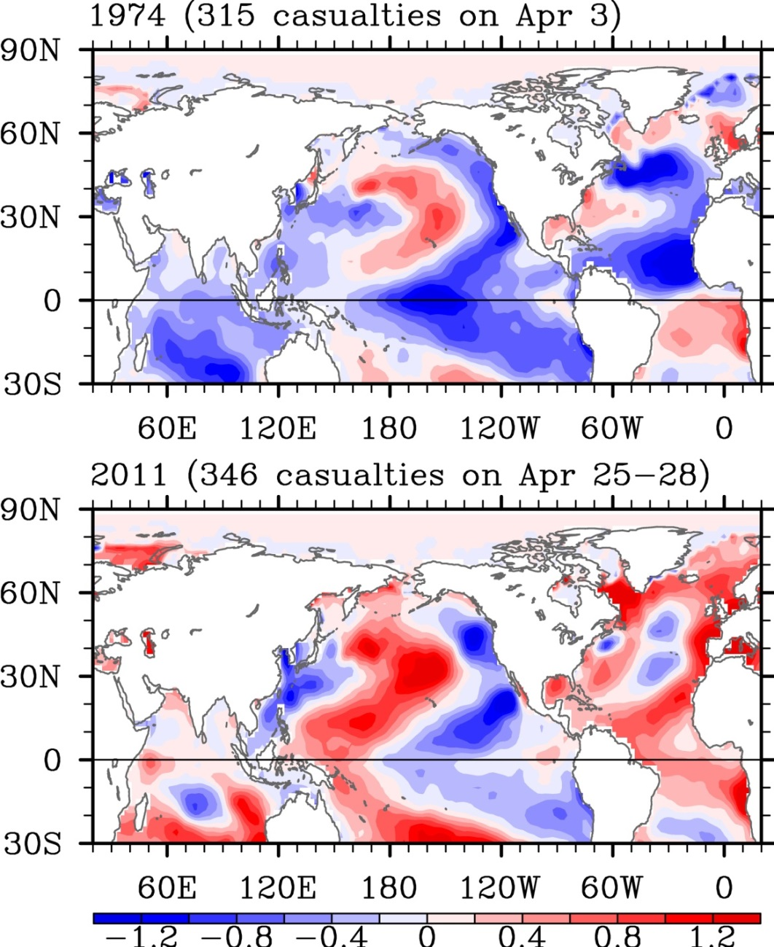
Seasonal Prediction System for U.S. Tornado Activity
(+) Trans-Niño: zonal gradient of SST anomalies along the equatorial Pacific between CP & EP > 0 (occurs during decay phase of La Niña)
However, the anomalous equatorial Pacific SST patterns linked to (+) Trans-Niño are all different case by case.
Lee et al. 2013; Lee et al. 2016; and Lee et al. (submitted)
Funded by: NOAA/OAR

Slide 12
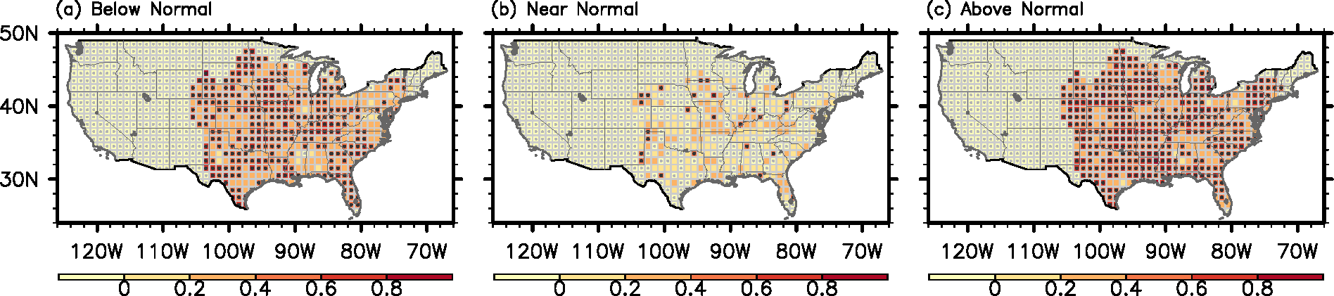
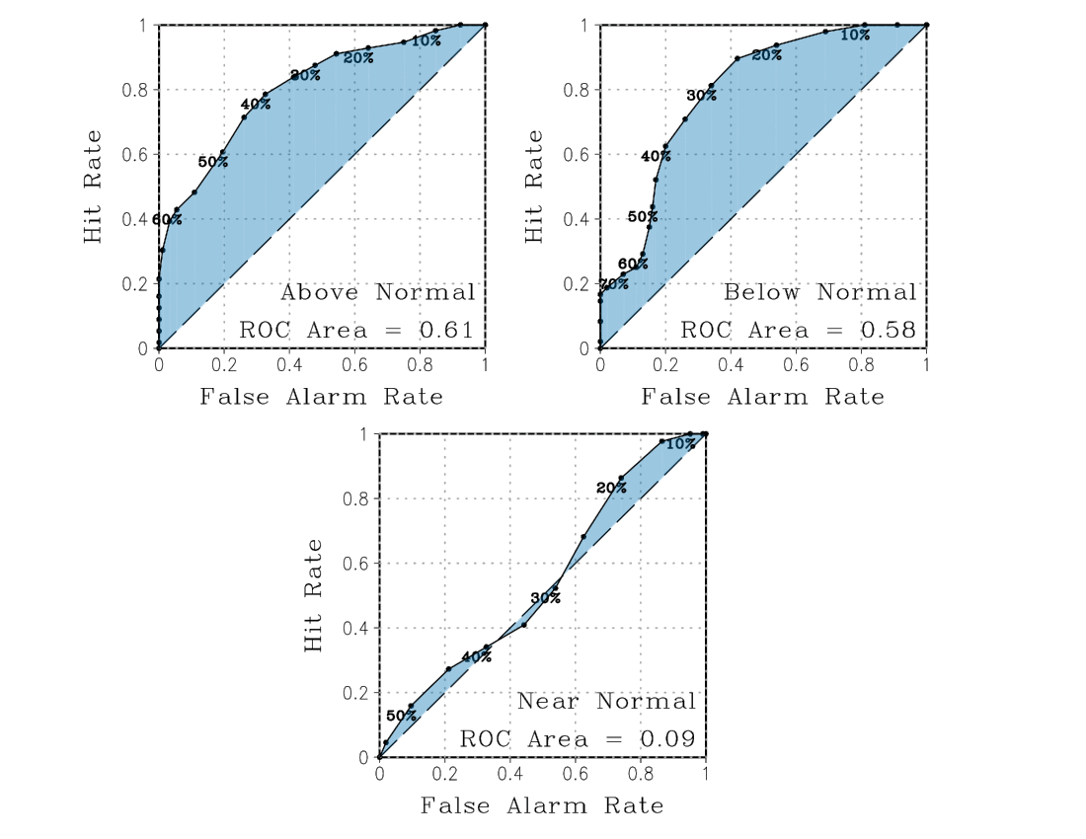
Probabilistic forecast skill for the U.S. regional tornado activity
Lee et al. (submitted)

Slide 13
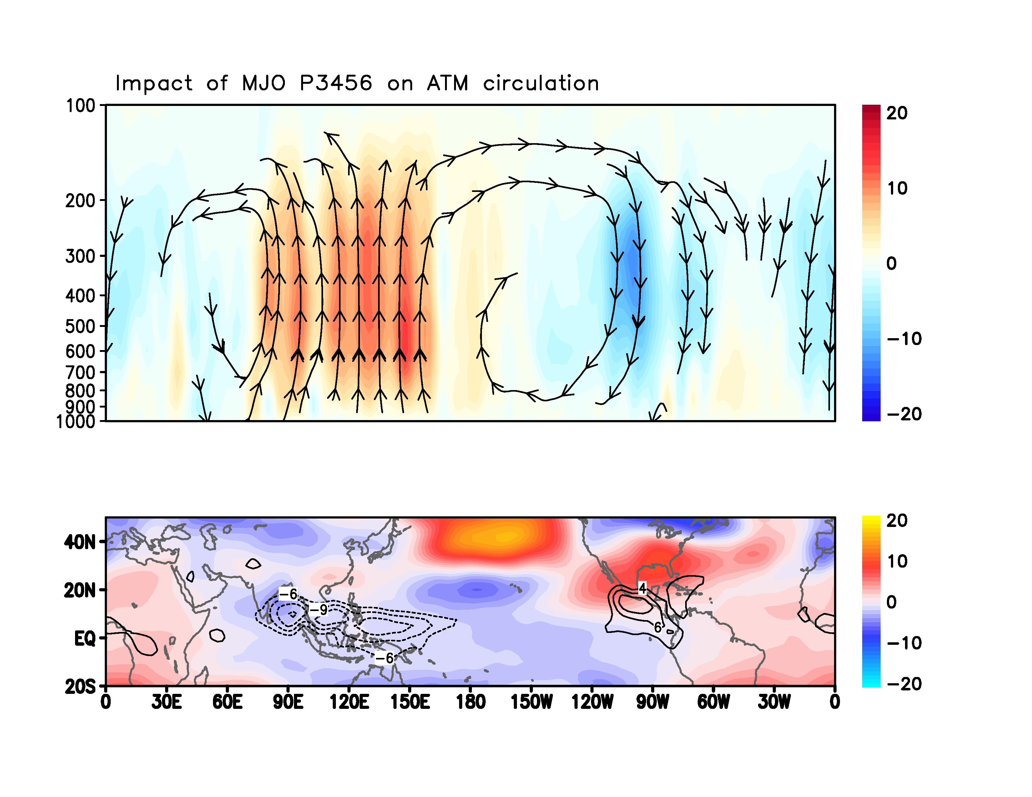
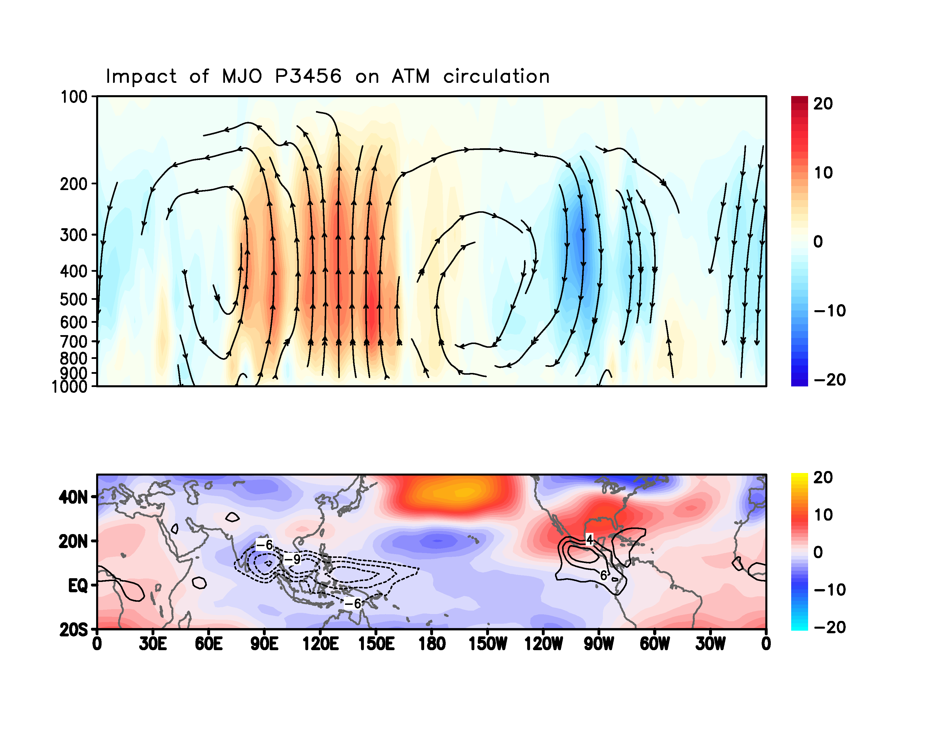



Sub-seasonal Tornado Outlook
Divergence
Convergence
Diabatic
warming
Diabatic
cooling
Shaded: - Omega (*800 pa/s)
Enhanced NALLJ
Gill-type response
Contour: OLR (W/m2), Shaded:500 hPa geopotential height (gpm)
MJO Phases3-6-induced convection with diabatic heating over the Maritime Continent (MC)
Enhanced US tornadogenesis during MJO Phases 3-6
Kim et al. (in preparation)
Funded by: NOAA/OAR

Slide 14
Summary
We showed physical links between the state of the ocean and high impact extreme weather events (heat waves and tornadoes).
Changes in the Atlantic MOC influences the occurrence of heat waves in the U.S. as well as global monsoon precipitation.
Monsoon precipitation can be used as a predictor of heat waves in the U.S.
We are currently working in the development of a sub-seasonal-to-seasonal (S2S) prediction system for extreme weather events (i.e., tornadoes and heat waves).

Slide 15
THANK YOU

