Slide 1

Partnerships supporting transitions to operations
Shirley Murillo

Slide 2
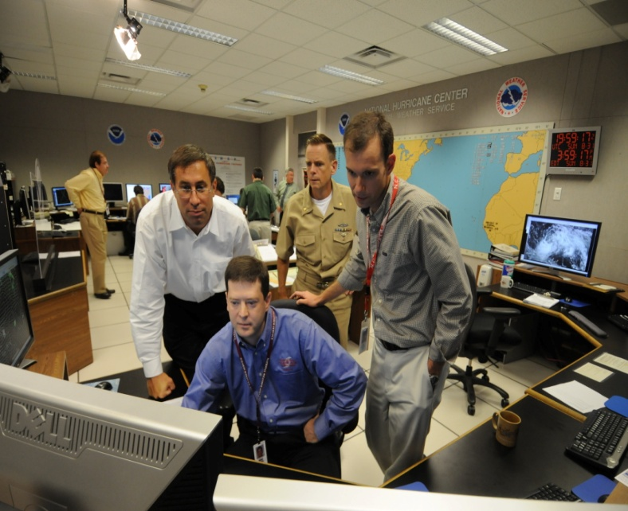
Joint Hurricane Testbed
Since 2001
Formal transition process
Transfer research results, new technology and applications
Testing done at National Hurricane Center, Environmental Modeling Center, and Central Pacific Hurricane Center
JHT is funded by OAR’s Office of Weather and Air Quality
Reference: Rappaport et al. 2012 - BAMS

Slide 3
Transitions via the Joint Hurricane Testbed
95
27
21
Projects funded
HRD projects
HRD projects accepted for transition

Slide 4
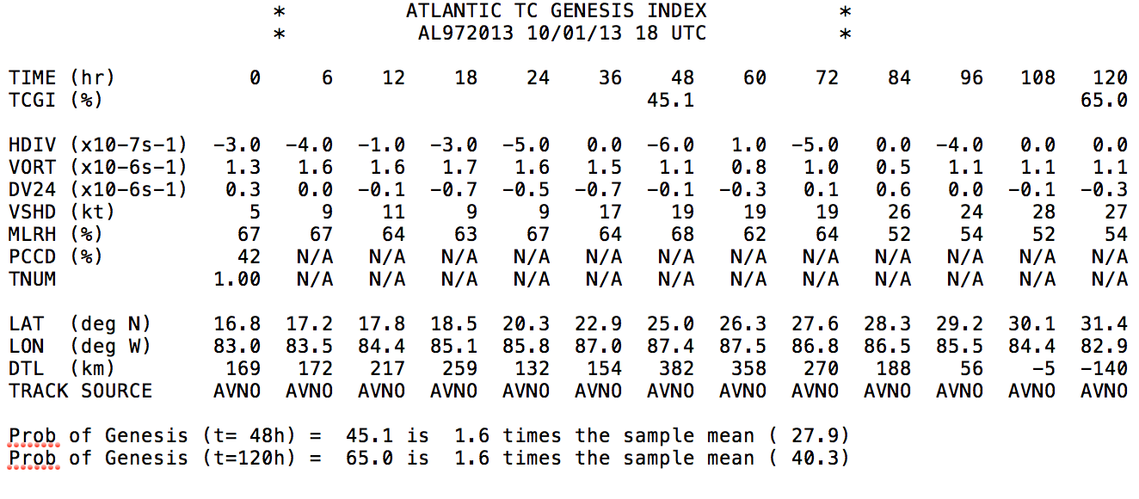
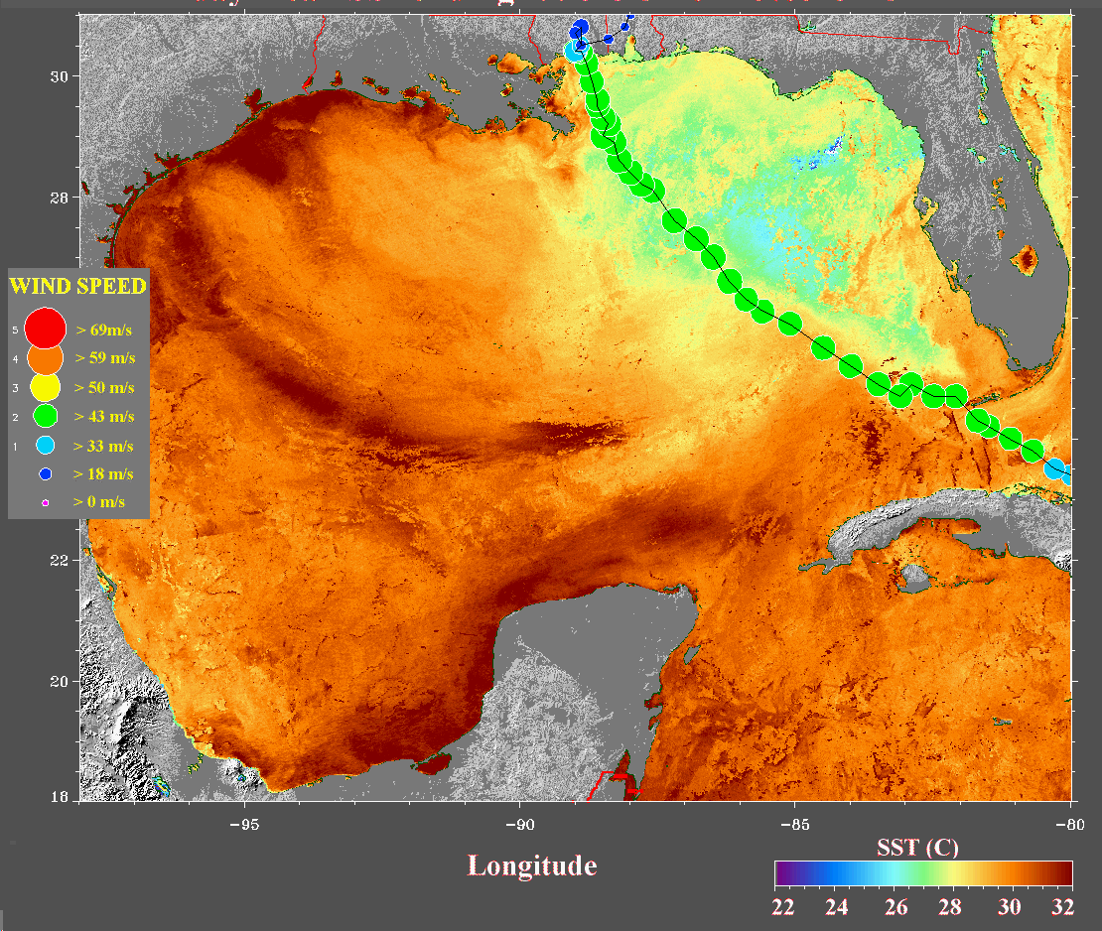
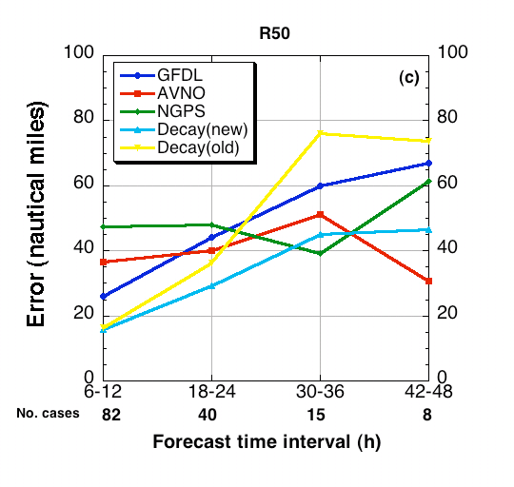
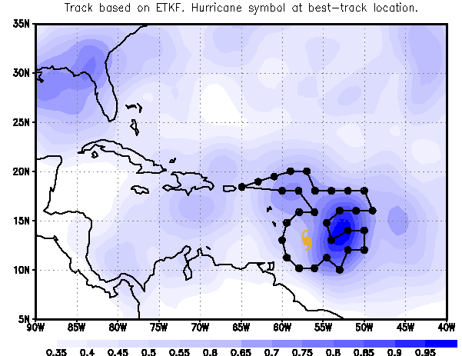
Tropical Cyclone Genesis Index
Sea surface temperatures as a predictor in hurricane intensity scheme
Including wind radii information in inland decay wind model
Targeting strategies to improve track forecasts

Slide 5
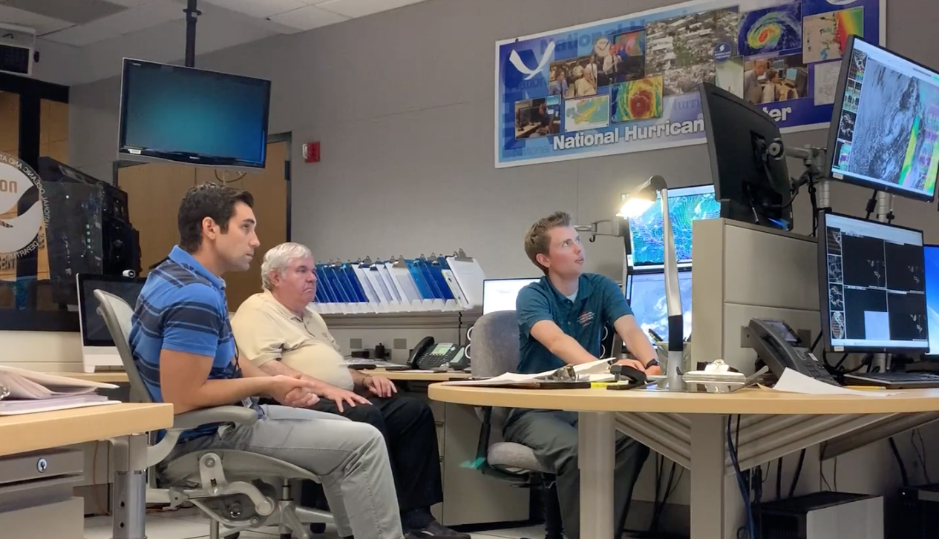
Notes:
HRD researches are working side by side with NHC forecasters

Slide 6
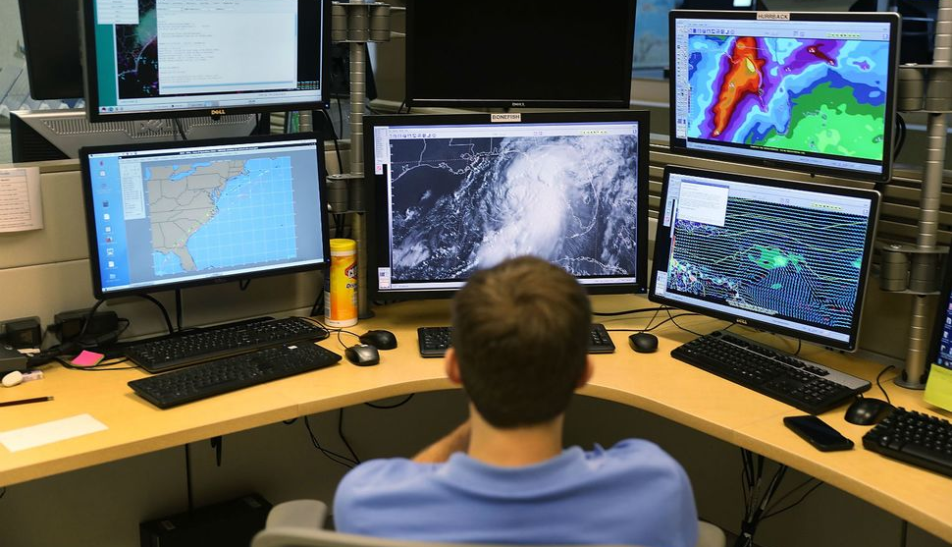
Notes:
Experience their operational environment
Learn about their decision making process
Time-constraints

Slide 7
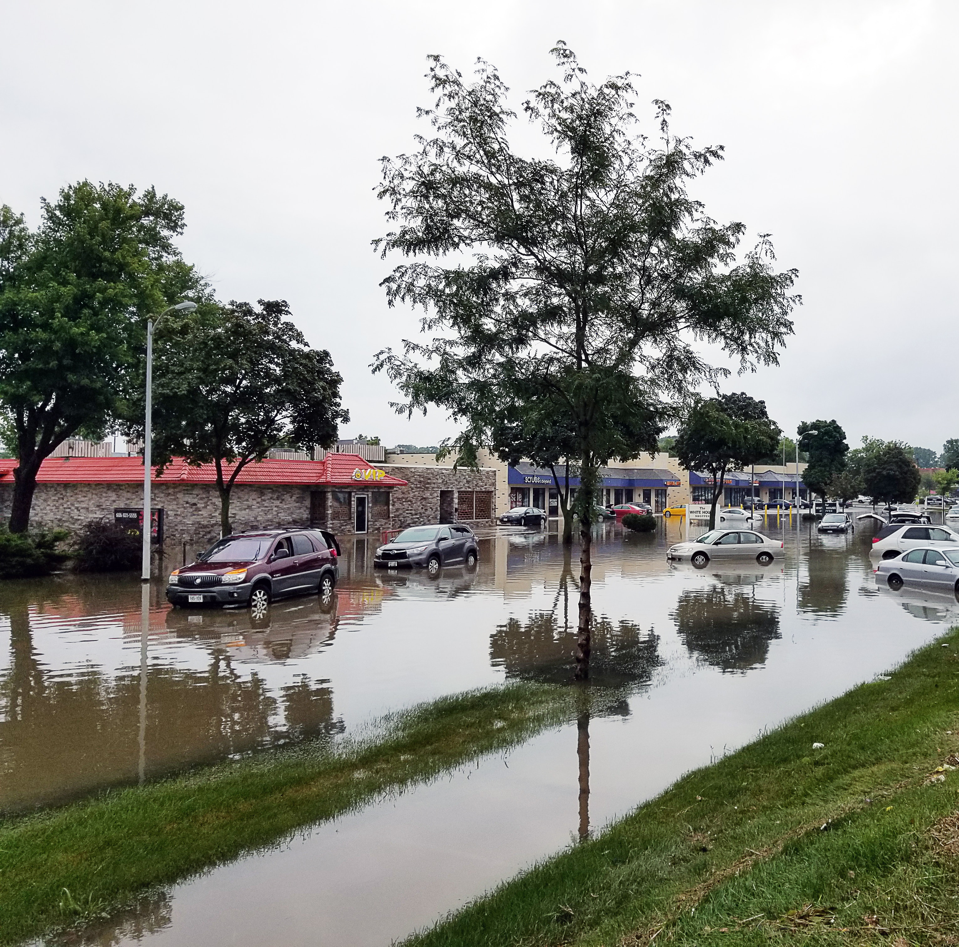
Weather Act 2017
Section 104: “NOAA must improve hurricane forecasting including”…
  Risk communication research to create more effective watch and warning products.
Notes:
Risk communication also aligns with HFIPs new strategic goals

Slide 8
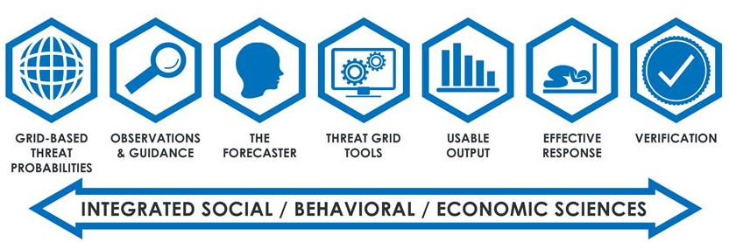
FACETs is…
Forecasting a Continuum of Environmental Threats
A framework that modernizes the creation, communication, and dissemination of risk-based, probabilistic hazard information to empower effective response

Slide 9
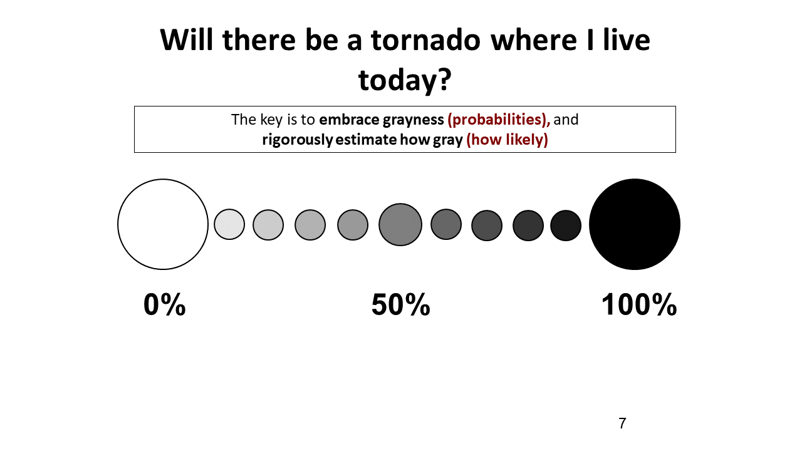
Embrace Grayness
Will the hurricane make landfall in my area?
The key is to embrace grayness (probabilities) and rigorously estimate how gray (how likely)
Notes:
Probabilities are shades of gray

Slide 10
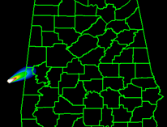
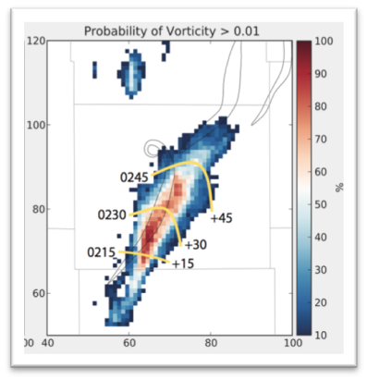
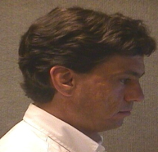
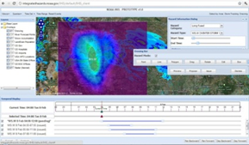
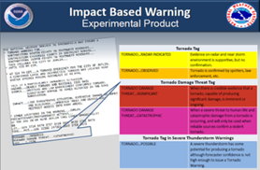
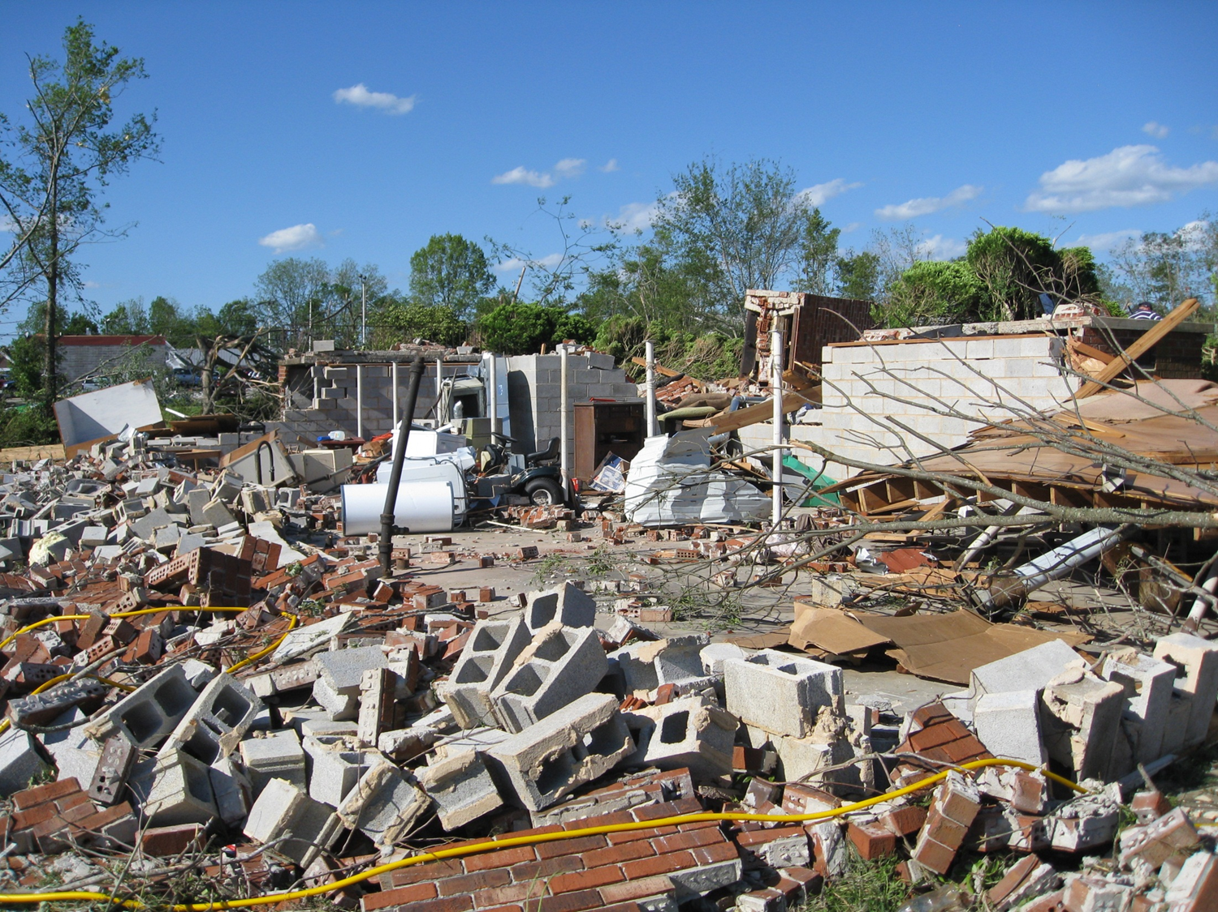
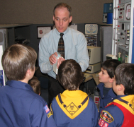
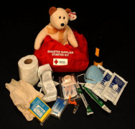
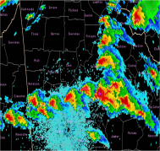

Integrate Social, Behavioral & Physical Sciences
Forecaster
The Impact
Method
Guidance
Decision
Tools
Output
Public
Education
Preparation
Awareness
Response
Notes:
The warning process needs to be viewed in a holistic sense, with (at least) two distinct tracks: The public track and the meteorologists’ track (although there are other tracks for EMs, media, private sector, etc.). There are key basic steps in each track that must be employed for effective public response. It all starts with the Impact or Trigger (or Causation). With this more complete view of the warning system, social science fits in throughout this entire process.

Slide 11

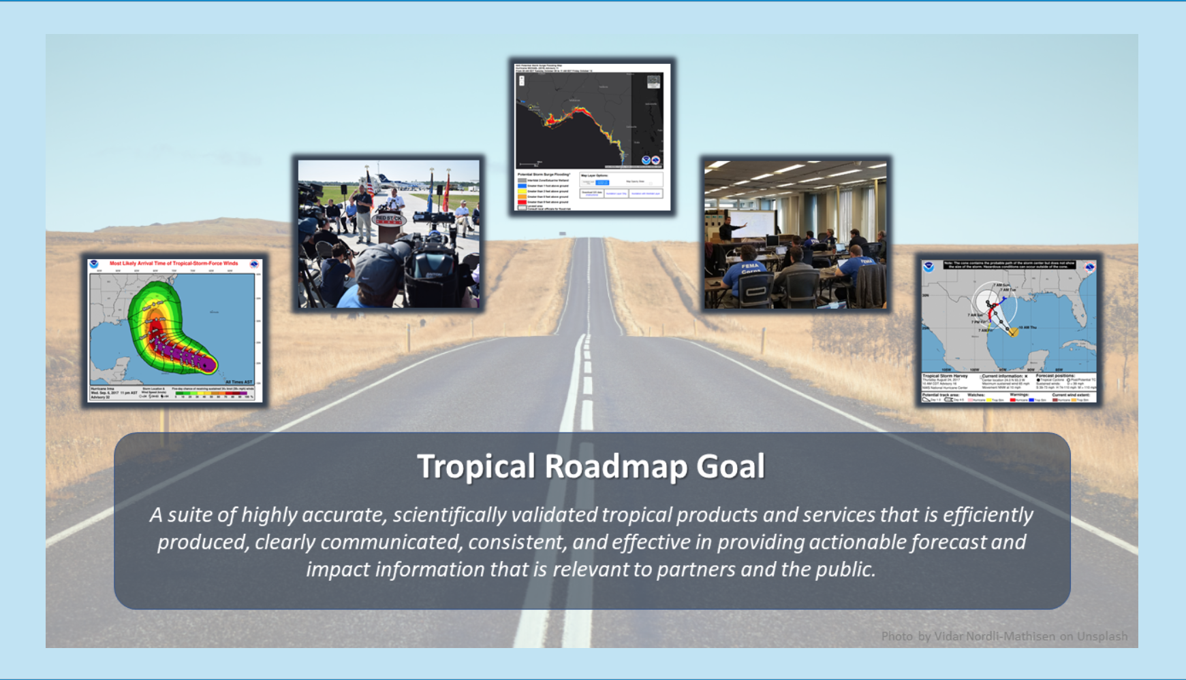
A suite of products the clearly communicate effective and actionable forecasts with impact information relevant to partners and the public.

Slide 12
High Threat Impacts Graphic
Impact based product
Easy to read
Color coded

Slide 13
THANK YOU

