Slide 1
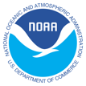
Collaborative Red Tide Research to Improve Community Resilience
Christopher Kelble, OCED

Slide 2
Red Tides are natural and occur all over the world. Florida Red Tides are caused by Karenia brevis.

Slide 3
The need for Red Tide Research
“Devastating” Red Tide blooms have severe negative impacts on coastal communities
2017-2019 bloom lasted 16-months and affected the entire Florida coast
Notes:
Red tides are almost a yearly occurrence on west Florida Shelf, but there is significant variability in persistence, intensity, and geographic distribution
little understanding of what makes a red tide bloom severe or what distinguishes between a devastating versus an intense bloom

Slide 4
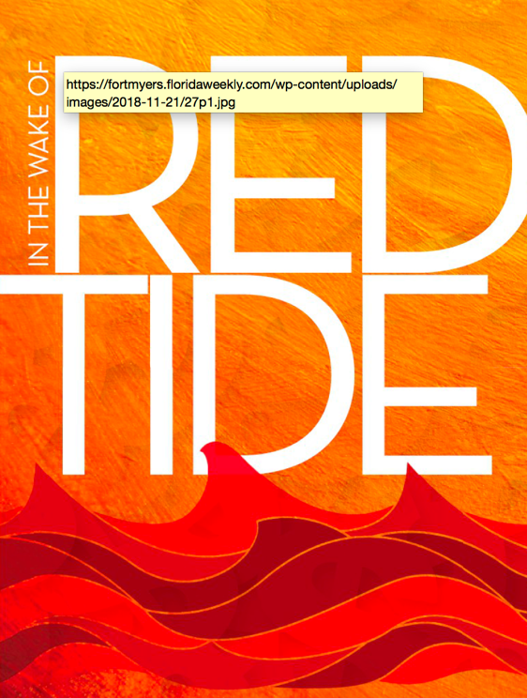
The need for Red Tide Research (2017-2019)
$48.8M lost revenue in 156 Ft. Myers Beach businesses during 13-week period (7/27/18-10/26/18)
Notes:
2017-2019 – 4th longest since 1953

Slide 5
The need for Red Tide Research (2017-2019)
$48.8M lost revenue in 156 Ft. Myers Beach businesses during 13-week period (7/27/18-10/26/18)
“My office was on fire, I didn’t know, and nobody told me”
Commercial Fishermen from Pine Island, FL
Notes:
2017-2019 – 4th longest since 1953

Slide 6
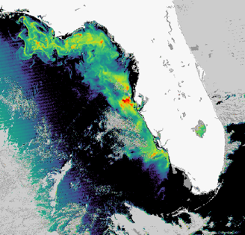
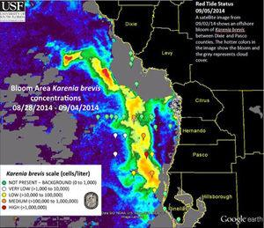
2005: AOML co-author’s paper on
MODIS red tide detection using SFER data to ground-truth
2010: AOML becomes co-lead on Gulf of Mexico IEA with SEFSC.
2013: GoM-IEA gets red tide mortality into Stock Assessment.
July 2018: SEFSC Workshop highlights devastating red tide
1998: AOML’s bimonthly South Florida Ecosystem Restoration Research (SFER)cruises begin
2001 Intense, but not devastating red tide
2005
2014
2017-19
Notes:
The July 2018 workshop with Fishermen, was done with partners in the Gulf of Mexico IEA and really kicked off our Red Tide research at AOML, because it helped us much better understand what is actually needed by coastal communities affected by red tide

Slide 7
2005: AOML co-author’s paper on
MODIS red tide detection using SFER data to ground-truth
2010: AOML becomes co-lead on Gulf of Mexico IEA with SEFSC.
2013: GoM-IEA gets red tide mortality into Stock Assessment.
July 2018: SEFSC Workshop highlights devastating red tide
1998: AOML’s bimonthly South Florida Ecosystem Restoration Research (SFER)cruises begin
2001 Intense, but not devastating red tide
2005
2014
2017-19
Notes:
The July 2018 workshop with Fishermen, was done with partners in the Gulf of Mexico IEA and really kicked off our Red Tide research at AOML, because it helped us much better understand what is actually needed by coastal communities affected by red tide

Slide 8
What are we trying to accomplish?
Increased Resilience of coastal communities
  Better information for fishermen
  Better understanding of devastating versus an intense or regular bloom
  Better quantification of socioeconomic impacts of devastating blooms
  Forecasts at seasonal to sub-seasonal

Slide 9
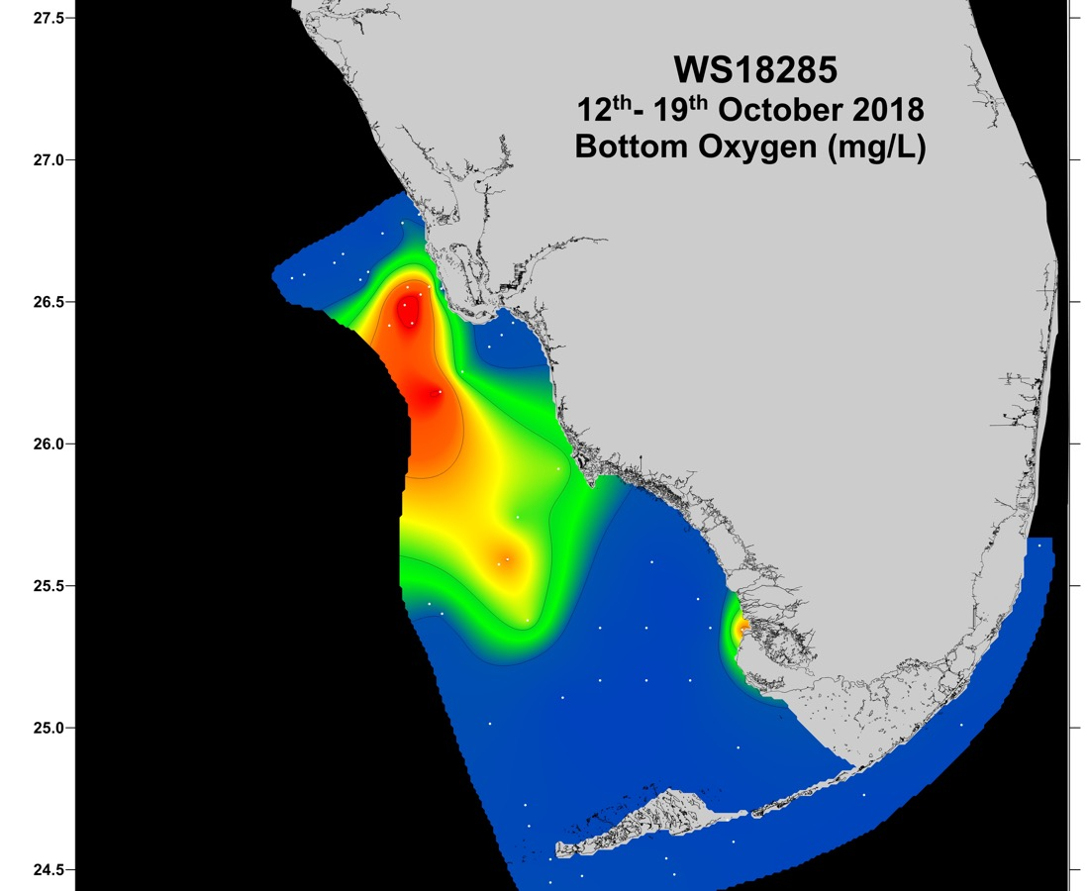
October 2018 –
The potential role of Hypoxia in Devastating Red Tides
Collaborators: State of Florida Fish and Wildlife Research Institute, University of Miami, Mote Marine Lab, Sanibel Captiva Conservation Foundation, Florida Gulf Coast University, University of Florida

Slide 10
October 2018 –
The potential role of Hypoxia in Devastating Red Tides
Collaborators: State of Florida Fish and Wildlife Research Institute, University of Miami, Mote Marine Lab, Sanibel Captiva Conservation Foundation, Florida Gulf Coast University, University of Florida

Slide 11
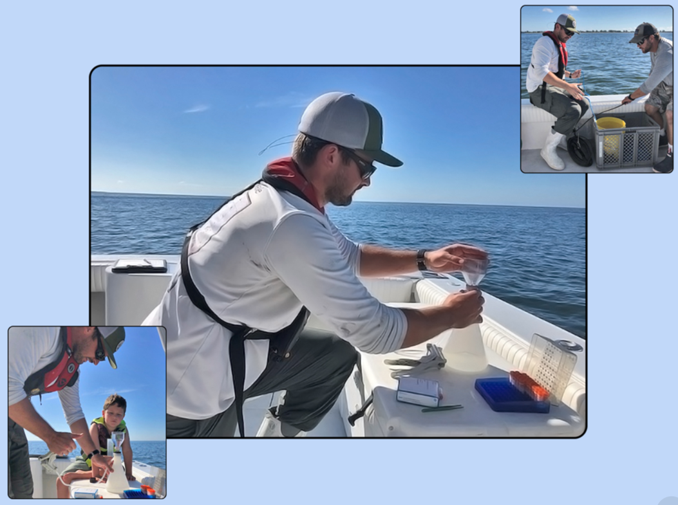
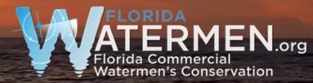

Collaborating with commercial fishermen to fill critical offshore data gaps

Slide 12
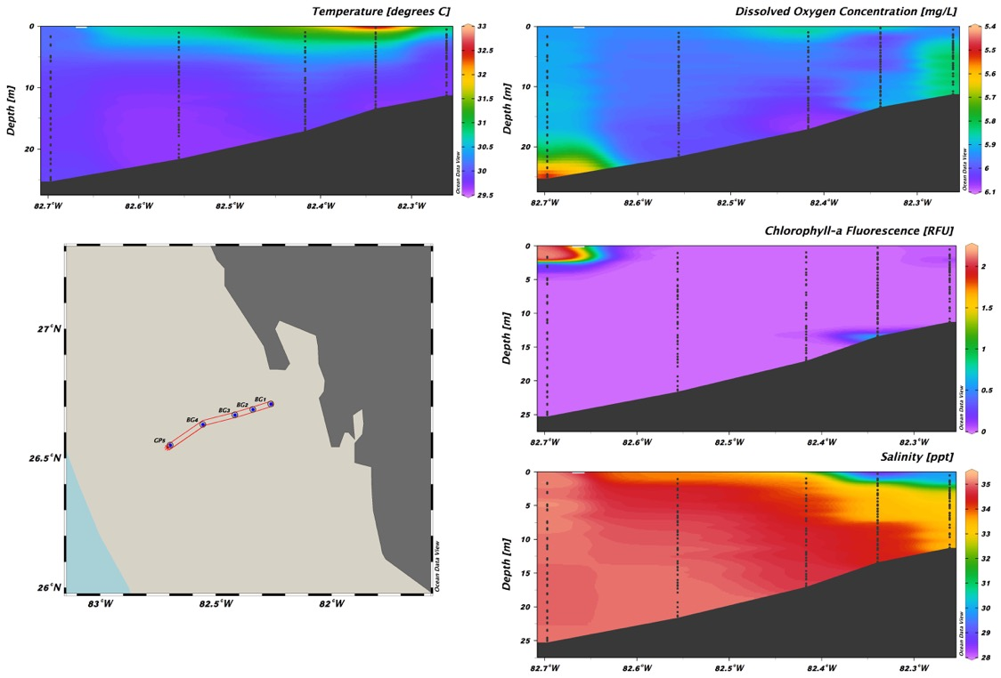

Collaborating with commercial fishermen to fill critical offshore data gaps

Slide 13
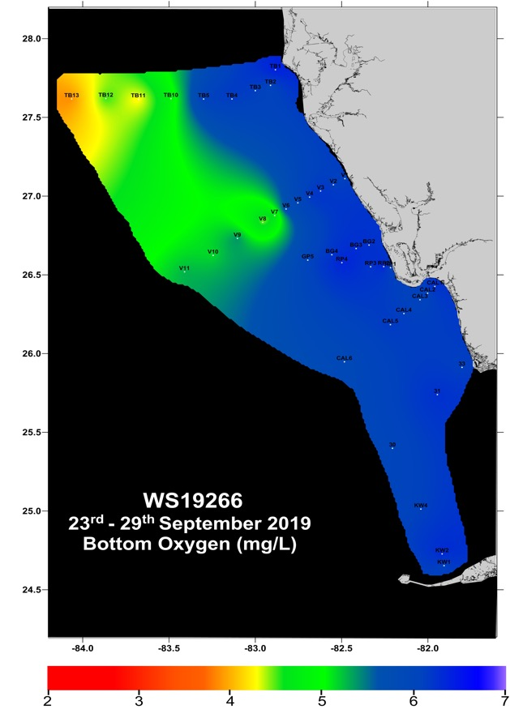
Comprehensive Red Tide research is now a part of the SFER cruises
Dissolved Inorganic Nutrients
Total nutrients
Particulate Nutrients
Trace Materials (Fe)
Chlorophyll a
Phytoplankton Community Composition
Dissolved Oxygen
Primary Productivity
Microzooplankton Grazing
Collaborators: State of Florida Fish and Wildlife Research Institute, University of Miami, Mote Marine Lab, Sanibel Captiva Conservation Foundation, Florida Gulf Coast University, University of South Florida

Slide 14
Comprehensive Red Tide research is now a part of the SFER cruises
Dissolved Inorganic Nutrients
Total nutrients
Particulate Nutrients
Trace Materials (Fe)
Chlorophyll a
Phytoplankton Community Composition
Dissolved Oxygen
Primary Productivity
Microzooplankton Grazing
Collaborators: State of Florida Fish and Wildlife Research Institute, University of Miami, Mote Marine Lab, Sanibel Captiva Conservation Foundation, Florida Gulf Coast University, University of South Florida

Slide 15
Socioeconomics of 2017-2019 Red Tide
Identify the people, assets, and economic activities at risk in the fishing community of the Charlotte Harbor region.
Produce accurate estimates of direct and indirect economic losses

Slide 16
Informing Stakeholders

Slide 17
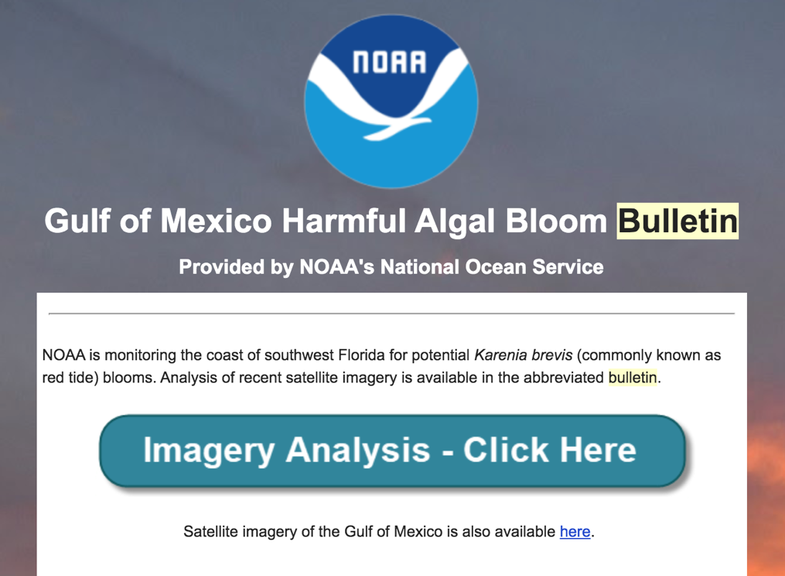
Informing Stakeholders

Slide 18
NOAA strategic objectives
Blue Economy
Public-Private Partnership
Engage and train coastal communities with science-based prevention and preparedness tools
NOAA Research Strategic Plan
Resilient Coastal Communities and Economies
NOAA Research (OAR) Corporate Priorities
Detect changes in the ocean and atmosphere

Slide 19
Next Steps:
Expanded Commercial Fishermen monitoring up and down the coast
Determine processes that create “devastating” red tides
Publish article on hypoxia
Develop seasonal or sub-seasonal predictions of the likelihood of devastating blooms

Slide 20
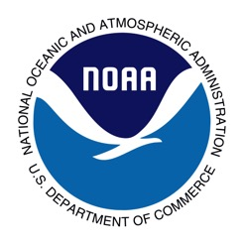
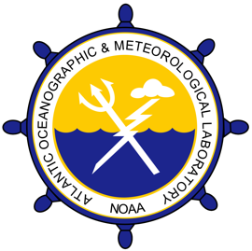

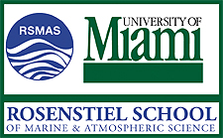
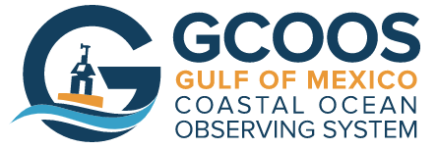
Thank you!

