Slide 1

Optimizing observing system strategies for tropical cyclone applications
Lidia Cucurull

Slide 2
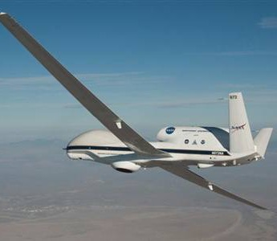
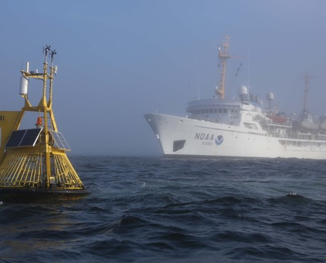
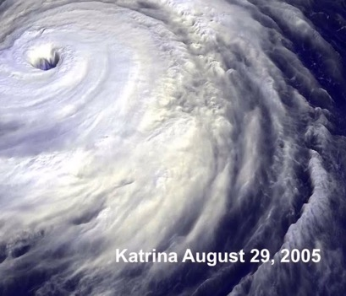
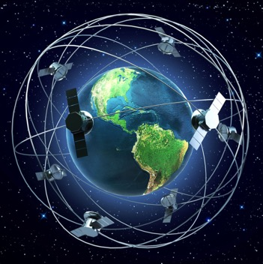
Observations

Slide 3
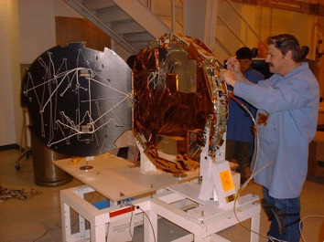
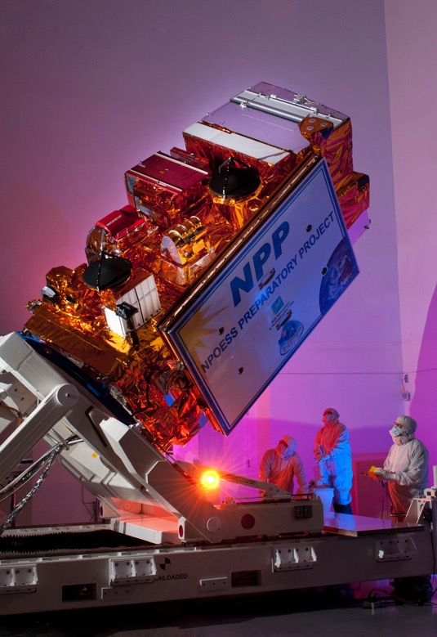
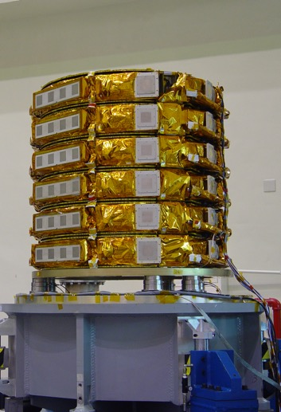
Evaluating Impact
Quantitative information.
Mix of current and/or proposed instruments.
Data assimilation and sampling strategies.
Cost-benefit analysis.
Prioritize observing strategies.
Coordination across NOAA.
Notes:
Provide quantitative information on the impact of new observing systems to improve tropical cyclone applications.
Evaluate the impact of alternative mix of current and/or proposed instruments.
Optimize data assimilation and sampling strategies.
Perform cost-benefit analysis for better planning and decision making.
Prioritize observing strategies in a cost-effective way.

Slide 4
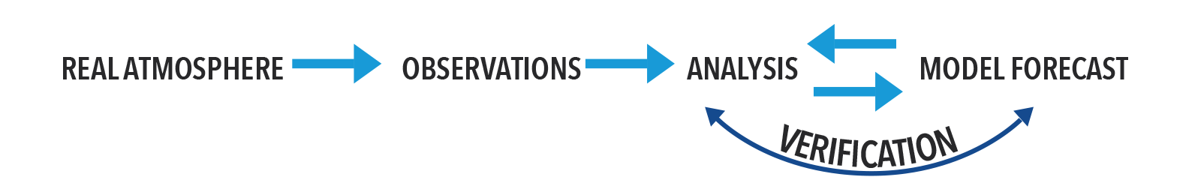
Quantitative Assessment Methodologies
OBSERVING SYSTEM EXPERIMENTS (OSES)

Slide 5
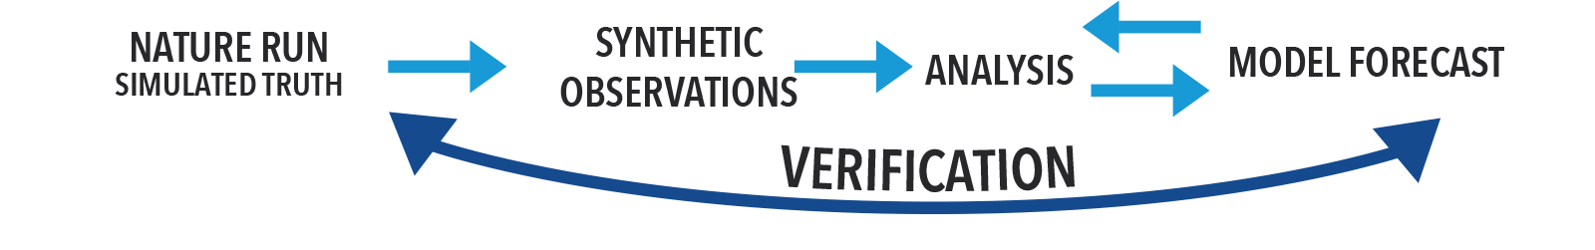
Quantitative Assessment Methodologies
OBSERVING SYSTEM SIMULATION EXPERIMENTS (OSSES)
Notes:
Requirements for an OSSE system:
A long atmospheric model integration using a “state of the art” numerical model to provide a complete record of the assumed true state of the atmosphere, usually referred to as the nature run. The nature run should represent the main characteristics of the real atmosphere, e.g. right climatology, general patterns of storm tracks, etc.
Simulated existing conventional and satellite observations from the nature run. These synthetic observations need to be simulated with the same spatial and temporal coverage, resolution, and accuracy as in the real world.
Generation of new proposed observations from the nature run with realistic coverage and accuracy.
An assimilation system, where the synthetic observations from both the current and proposed instruments will be assimilated and evaluated. This assimilation system should be of lower resolution than the nature run. Realistic differences between the nature run and the model used for assimilation and forecasting should exist, and ideally they should approximate the differences between a state-of-the art assimilation system and the real atmosphere.
Calibration of the entire OSSE system to ensure that the accuracy of analyses and forecasts, and the impact of existing observing systems in the OSSE environment are comparable to the accuracies and impacts of the same observing systems in the real world.
The benefits of a proposed observing system are quantified by comparing the forecasts with and without the proposed observing system against the nature run.

Slide 6
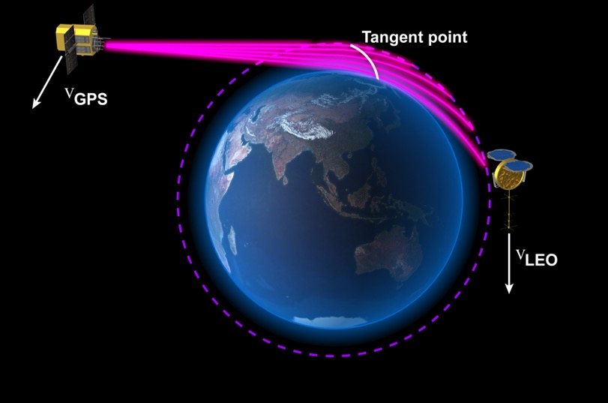
COSMIC-2 Satellite Mission
1,300 profiles/day
polar orbits
COSMIC-1
6,000 profiles/day
equatorial orbits
(launched in 2019)
Soundings of temperature to improve weather models
Radio Occultation Concept
COSMIC-2 (cyan)
Notes:
An occultation occurs when a GPS (or any GNSS, Global Navigation Satellite System) satellite rises or sets across the limb with respect to a LEO (Low Earth Orbit) satellite
A ray passing through the atmosphere is slowed and is refracted (bent) due to the vertical gradient of density and moisture in the atmosphere
During an occultation (~ 3 min) the ray path slices through the atmosphere
Raw measurement is traceable to an absolute SI standard – assured long-time stability. So,
Unbiased raw measurements
No drift, no need for calibration

Slide 7
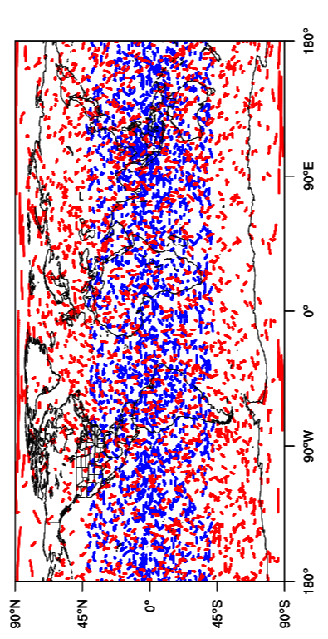
Spatial distribution
6 h assimilation time window
COSMIC-2 (6 equatorial)
Original COSMIC-2 (+6 polar)

Slide 8
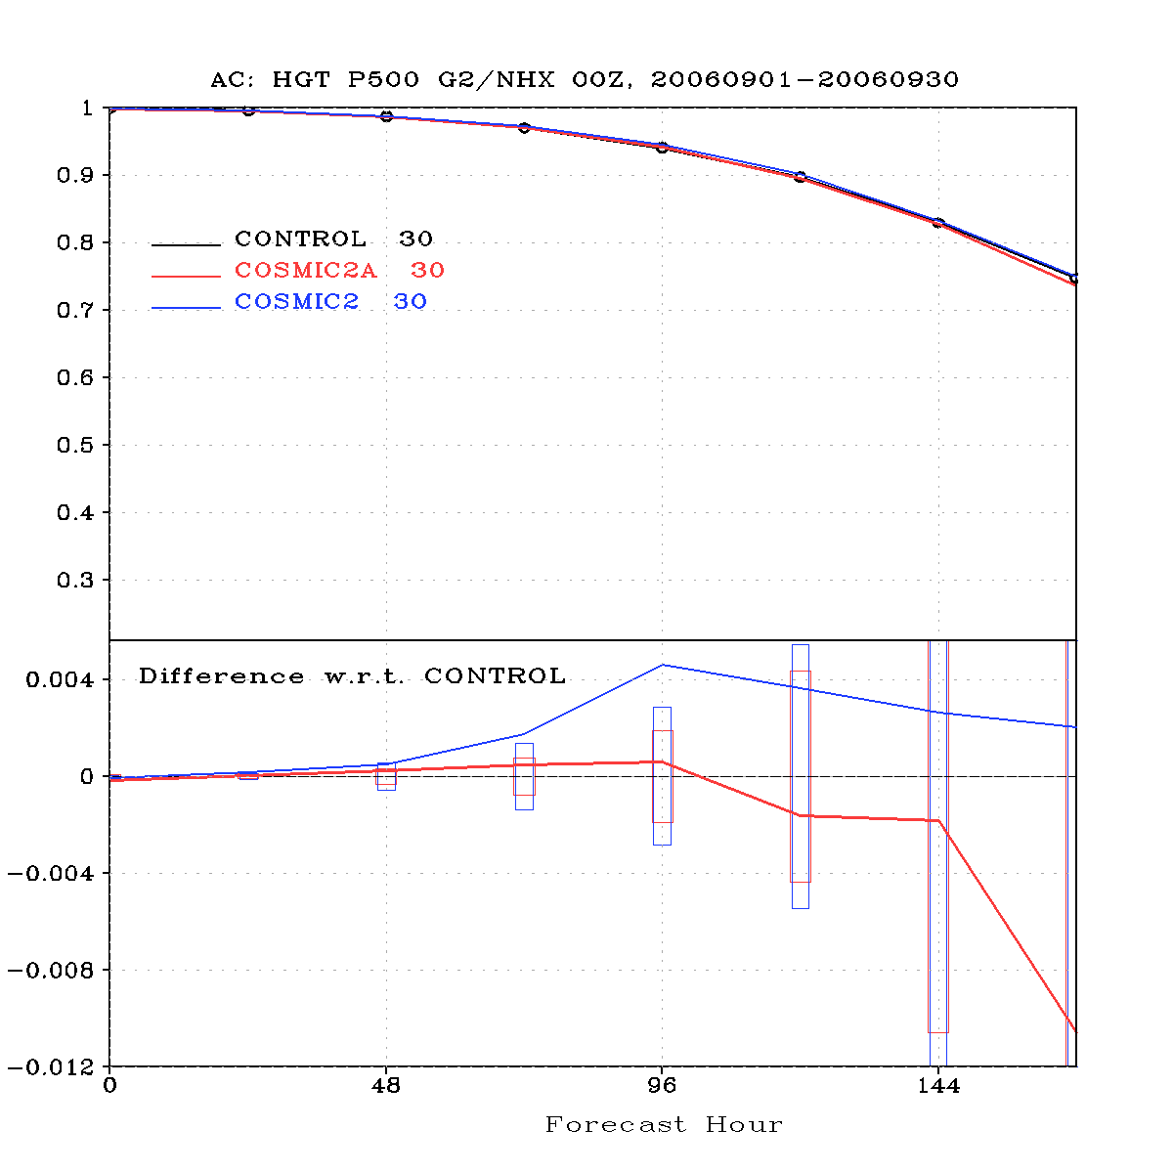
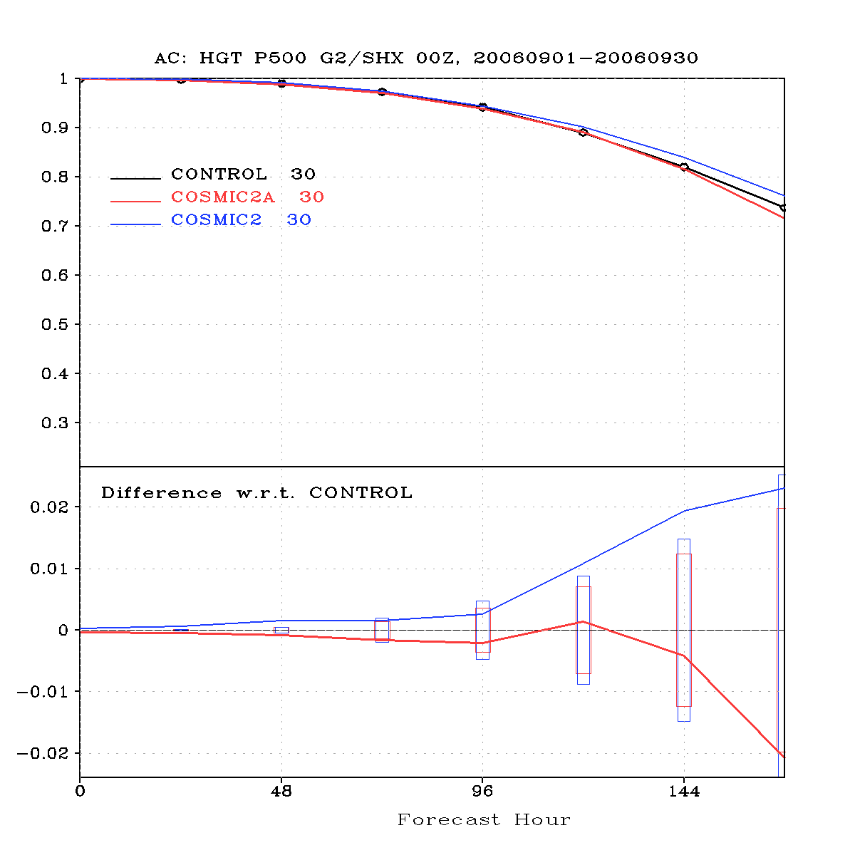
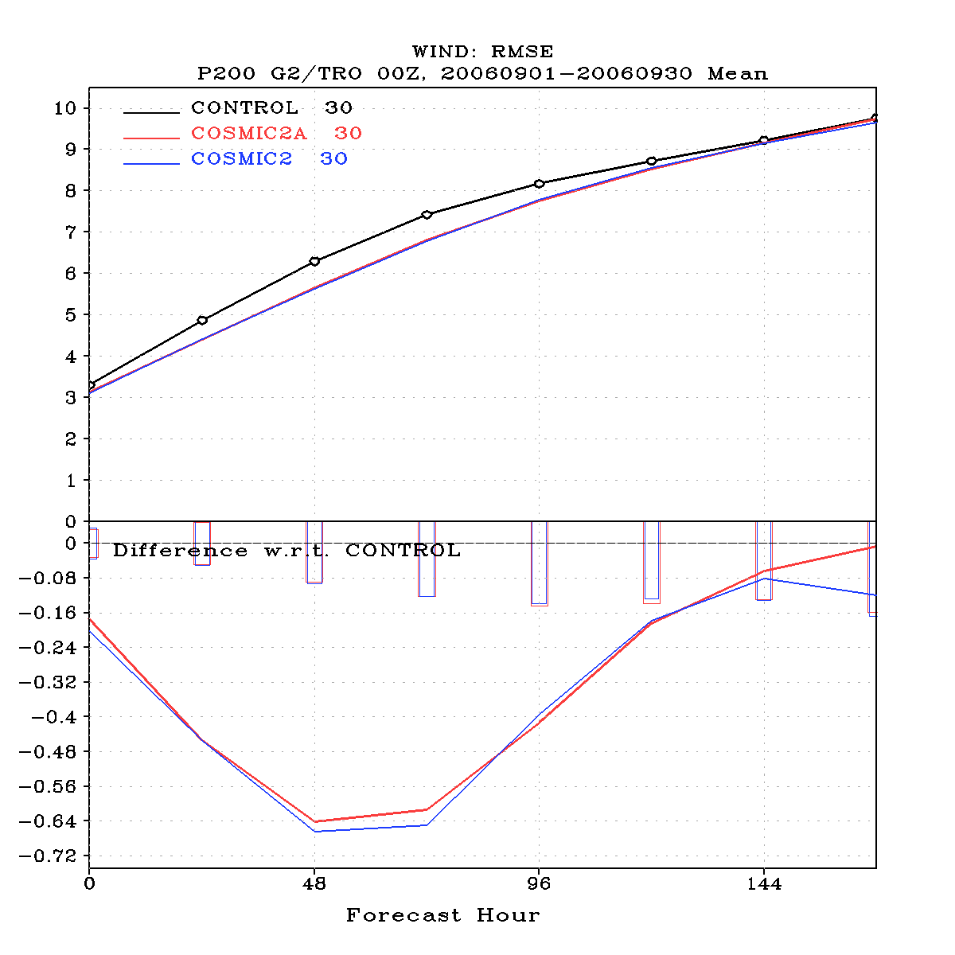
OSSEs with COSMIC-2
Global spatial distribution of COSMIC-2 observations is needed to improve weather forecast globally
CTL: operational satellite radiances and conventional observations (no RO)
COSMIC2A:
CTL + 6 equatorial COSMIC-2 satellites
COSMIC2:
CTL + 6 COSMIC-2 equatorial satellites + 6 COSMIC-2 polar satellites
500-hPa Anomaly correlation NH
500-hPa anomaly correlation SH
200-hPa RMSE Winds TROP
Better
Worse
Better
Worse
Better
Forecast hour
Forecast hour
Forecast hour

Slide 9
Thank you!

